Slide 1
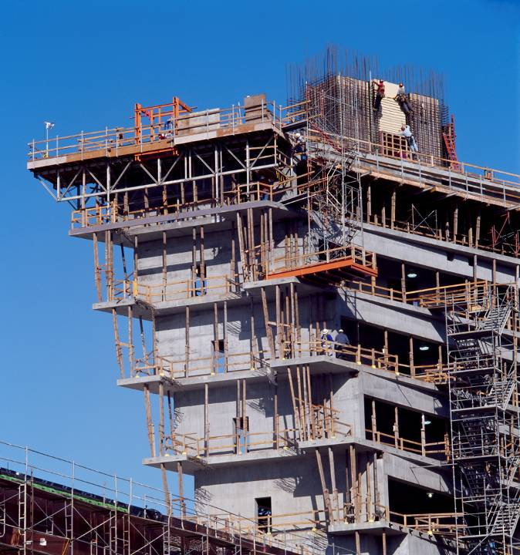




Revit 2010 API Jeremy Tammik Saikat Bhattacharya AEC Workgroup DevTech Autodesk
Image Courtesy of RTKL Associates Inc

Slide 2
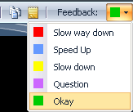
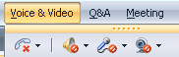
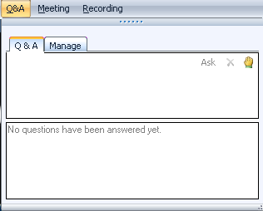
Before we start LiveMeeting and conference call – how to
Introduction
Use Internet Audio
Full Screen Mode
Provide feedback
Real-time Q&A
Mute phone *6
Expand to full screen mode
Press ESC to return
Notes:
This conference is muted, so you cannot hear anybody else than me talking, and cannot provide feedback through the phone conference. We will unmute it and open it up for general discussion and questions and answers at the end. Meanwhile, written questions can be entered in the live meeting console and will be answered in real-time during the presentation by my colleagues. Thank you very much for that support! Since I will be switching back and forth between these slides and live demonstrations in Revit and Visual Studio, I will set my computer to low resolution and full screen mode to reduce bandwidth and speed up the display. This means I will not see the live meeting console and the feedback panel. My colleagues will be monitoring the livemeeting console and also answering questions online. We will post the materials from this presentation together with the audio recording. We encourage you to use the live meeting internet audio facility, rather than the telephone conference call.

Slide 3

About the Presenter
Introduction
Jeremy Tammik
Developer Technical Services
EMEA, Autodesk SARL
Jeremy is a member of the AEC workgroup of the DevTech team, providing developer support, training, and conferences to the Autodesk Developer Network ADN. He originally joined Autodesk in 1988 as the technology evangelist responsible for European developer support. In this capacity, he wrote articles, consulted, lectured on AutoCAD application programming techniques, and supported AutoCAD application developers in Europe, the U.S., Australia, and Africa. He was a cofounder of ADGE, the AutoCAD Developer Group Europe, and a prolific author on AutoCAD application development. He left Autodesk in 1994 to work as an HVAC application developer, and then rejoined the company in 2005.
Jeremy graduated with a MA in mathematics and physics in Marburg, Germany, in 1984, and worked first as a teacher and translator of both computer and human languages, then as a C++ programmer on early GUI and multitasking projects. He is fluent in five European languages, vegetarian, has four kids, plays the flute, likes reading, travelling, theatre improvisation and carpentry, loves mountains, oceans, sports and especially climbing.
Notes:
It is my pleasure to work in the AEC workgroup of the DevTech team supporting the Autodesk Developer Network ADN.

Slide 4

About the Presenter
Introduction
Saikat Bhattacharya
Developer Technical Services
Autodesk India
Saikat is a member of the AEC workgroup within the Developer Technical Services (DevTech) team in Autodesk. He has been associated with Autodesk for close to 5 years now and was working with Autodesk Consulting before joining DevTech. Prior to joining Autodesk, Saikat worked as GIS software developer in Philadelphia and as a project architect in the construction industry in New Delhi.
Saikat holds a Bachelors degree in Architecture (India) and a Masters of Science degree in Informatics and Architecture (US).

Slide 5
About the AEC Workgroup
Introduction
An international team
Mikako Harada AEC Workgroup Lead Manchester
Adam Nagy Developer Consultant Farnborough
Akira Kudo Developer Consultant Tokyo
Joe Ye Developer Consultant Beijing
Katsuaki Takamizawa Supervisor, DevTech Japan Tokyo
Saikat Bhattacharya Developer Consultant Bengaluru
Jeremy Tammik Developer Consultant Neuchâtel

Slide 6
Agenda
Introduction
Introduction
Product, SDK, documentation and samples
Getting Started and Hello World
Development environment, external command and application interfaces, modifying Revit.ini, RvtSamples and RvtMgdDbg
Basics
Database and elements: identifying, filtering, manipulation
Families and types: standard versus system, loading, changing type
Parameters: built-in versus shared, exchange with external applications
Geometry
Break
API Updates
Ribbon, Events, VSTA
API News
New samples
Family API and form creation
MEP API
Notes:
What are the initial steps in creating a Revit application? The first thing is to understand is what material is provided by the SDK, the API architecture, and where to obtain more information. Then we explore how to set up the development environment and create a first "Hello world" type application. After that, we will look into the Revit database structure and its data and elements. The samples provide a valuable knowledgebase on how to solve Revit programming tasks. Then we go through the basics, which are unchanged from the previous release. After the break, we dive into the host of new topics.

Slide 7
Polls About You
Introduction
1. What category best describes your main professional activity?
Architect, Engineer, Constructor, Programmer, Manager, Other
2. How would you rate your level of experience with the Revit products?
Very experienced, Quite experienced, Not experienced
3. How would you rate your level of experience with the Revit API?
Very experienced, Quite experienced, Not experienced
4. Which statement best describes you?
This topic directly affects my work today
I expect this topic to be useful to me in the future
I'm evaluating this technology
None of the above

Slide 8
Acronyms
Introduction
ADN Autodesk Developer Network
AEC Architecture, Engineering, Construction
API Application Programming Interface
BIM Building Information Model
GUI Graphical User Interface
MEP Mechanical, Electrical, Plumbing
RAC Revit Architecture
RME Revit MEP
RST Revit Structure
SDK Software Development Kit
UI User Interface

Slide 9
Revit Products
Introduction
Three flavours of Revit product and API
Revit Architecture
Revit MEP: Mechanical, Electrical, Plumbing
Revit Structure
Product build and distribution
DVD version posted to ADN member web site
Software & Support > Revit > Downloads
Posted once only
Web version and Web Update version on Autodesk home page
Products > Autodesk Revit Architecture, MEP, Structure > Product Download
Latest download version from the public product site
English version uses service pack technology since 2009 WU2, no more full install
Localized versions are expected to follow in future

Slide 10
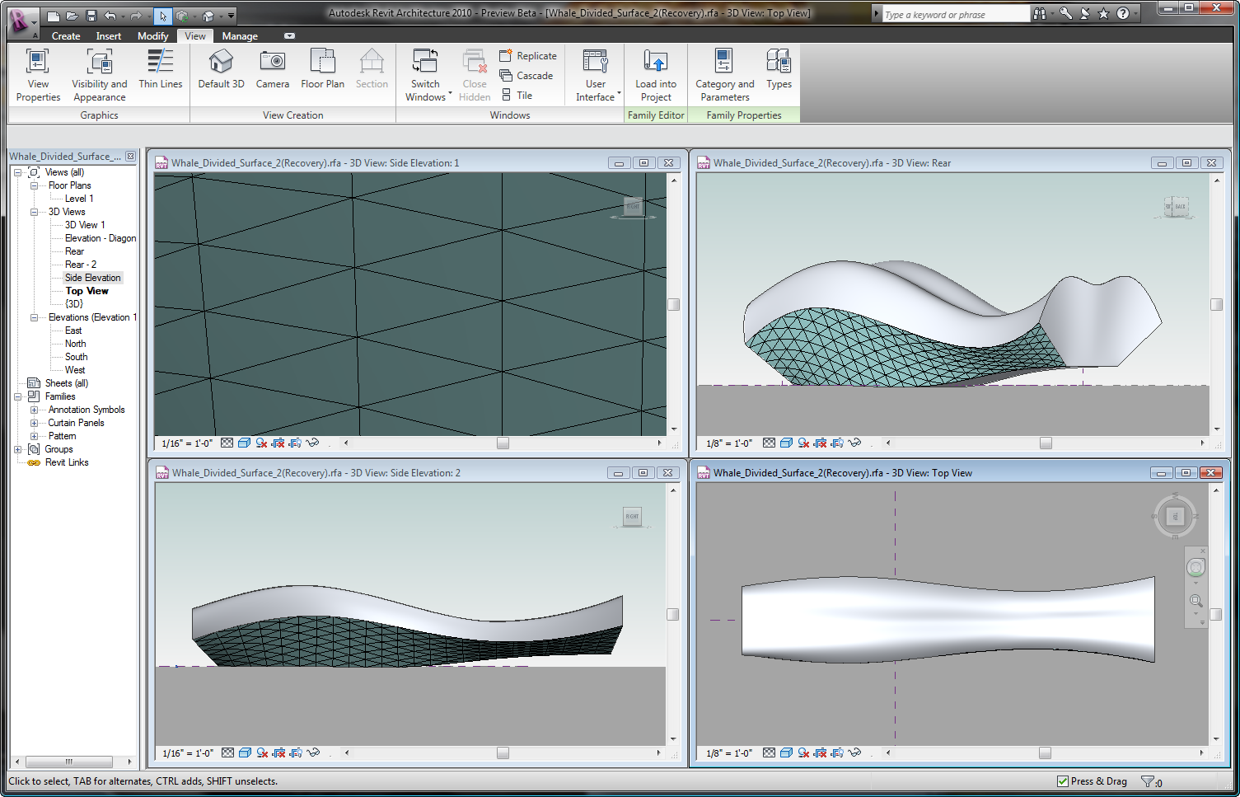
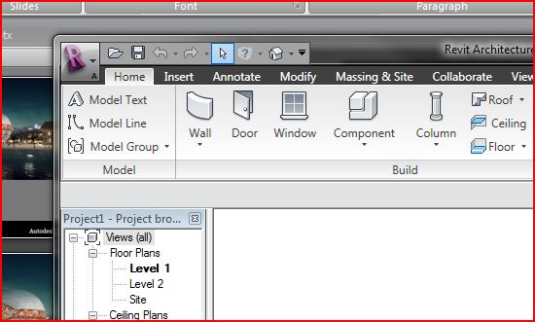
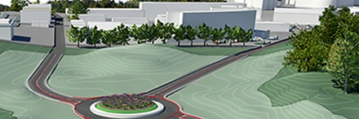
Revit Architecture 2010 Product Features
Introduction
Conceptual design – Complex geometry made easy
Intuitive and flexible form-making
Sketching enhancements
Divide, pattern, and panelize
Integrated workflow
User Interface – Improved productivity
Ribbon, application menu, and quick access toolbar
Enhanced integration with Autodesk Seek service
Enhanced tooltips
Performance and Interoperability
Native 64-bit support
Export to AutoCAD Civil 3D
Import content from Autodesk Inventor
gbXML improvements
API enhancements
Notes:
Autodesk Revit Architecture 2010 software streamlines your design workflows, improves the the user experiences and enhances collaboration by focusing on three key areas:
(1) With the 2010 release, Autodesk has created an elegant and enjoyable working space for conceptual design in Autodesk Revit Architecture. You can work intuitively and flexibly when making a form. Sketching has been enhanced with 3D view levels and reference planes. You can divide a surface, apply patterns and panels on a surface.
(2) The most noticable change in 2010 is the UI. Revit now uses Ribbon based UI, along with application menu, quick access toolbar and enhance tooltips. Users will now have a more productive/common experience as they work with multiple Autodesk products, since many share a common UI. A common user interface helps improve the learning curve and makes formerly hidden tools easier to find. Integration with Autodesk Seek has been greatly enhanced. You can publish to and search Autodesk Seek right from the Autodesk Revit Architecture UI.
(3) Revit 2010 supports native 64-bit. Design professionals will be able to collaborate even more effectively with the new Autodesk Exchange File format [.adsk ]. Importing and exporting more intelligent and data-rich files will help improve collaborative workflows between AutoCAD Civil 3D and Inventor.
gbXML export functionality has been enhanced; You can preview your room data at a detailed level before you export it to gbXML. You can view gbXML analytical model, surfaces color coded based on type of surface, and define energy data previously only available through Project Information dialog box.
Expansions to the API will provide designers with advanced conceptual modeling techniques and enable manufacturers to automate the creation of large and accurate content libraries.

Slide 11
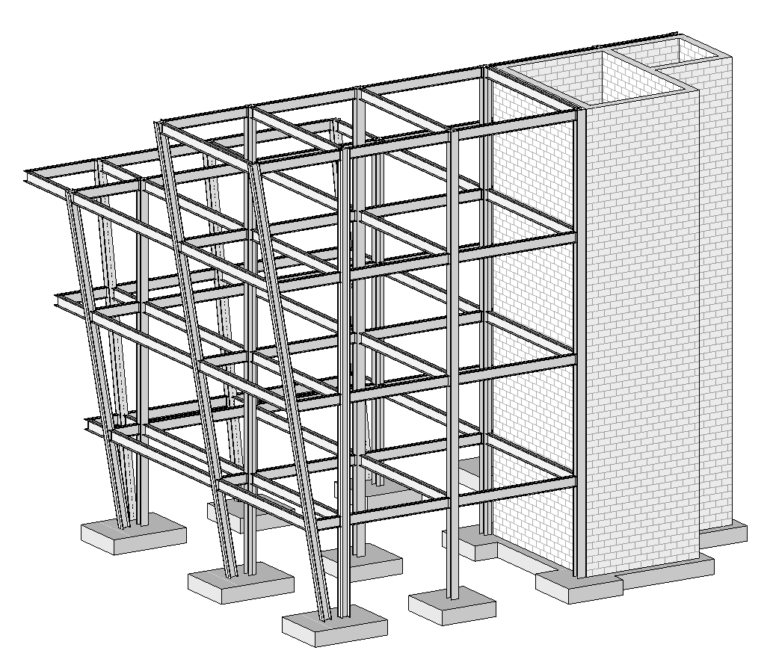

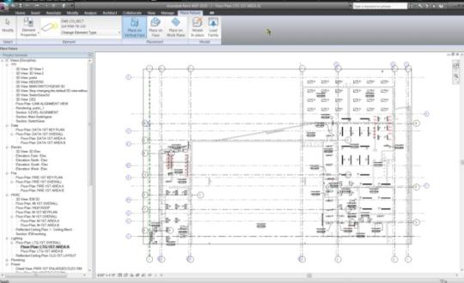
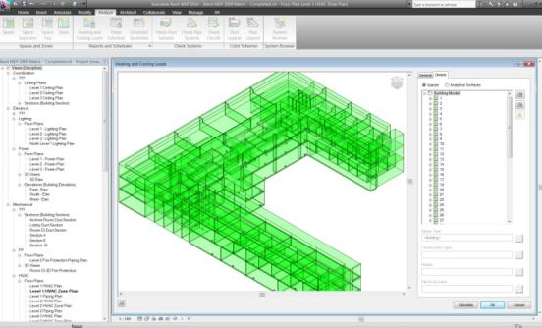

Revit 2010 Product Features
Introduction
Autodesk Revit Structure 2010
Enhanced modeling and analysis
Slanted columns
Bridge modeling
Steel connection modeling
Conceptual form analysis
Autodesk Revit MEP 2010
Sustainable Design and Analysis
Native Heating and Cooling Load Engine
Notes:
In addition to the the common features across all Revit products, Revit Structure and Revit MEP have the following specific enhancements:
Support for slanted columns.
Bridge modeling, steel construction modeling (such as beam-column end plate connections, or column base connections) and conceptual form analysis capabilities (by Robot structural analysis software), available to subscription customers.
Revit MEP software’s optimum tools for system design and building performance analysis helps engineers and designers make better decisions.
Autodesk Revit MEP provides native integrated heating and cooling loads calculation tools to help perform energy analysis. You can evaluate system loads, and produce heating and cooling load reports for a project.

Slide 12
Revit API and SDK
Introduction
The SDK is provided with the product
From Installer under 'Install Tools and Utilities'
Web and download version
<extraction folder>\support\SDK\RevitSDK.zip
or Revit2010SDK.exe
SDK Installer in Revit 2010 RTM temporary setup files
C:\Autodesk\RAC_2010_English_Win_32bit\support\SDK\RevitSDK.exe
*Please download latest update from Developer Center
http://www.autodesk.com/developer --> Revit
RevitAPI.dll is present in every Revit installation
Notes:
The Revit SDK is basically purely for support and documentation purposes. All you actually need to develop a Revit add-in is the development environment and the RevitAPI.dll, nothing else. The SDK install is located under the 'Install Tools and Utilities' menu on the main page of the Revit installer. (Note: there is another menu called “Utilities” you see right after the product installation, which contains only the link Content Batch utilities. Click on “Back to First Page” button to move back to the main page of the installer to install SDK.) Alternatively, you can also find the SDK in the extraction folder, under:
<extraction folder>\support\SDK\RevitSDK.exe
If you have accepted the default location, which typically looks like:
C:\Program Files\Autodesk\Revit XXX 2010 support\SDK\RevitSDK.exe
The SDK was recently modified, so please download the the latest update from the developer center. We are already updating the developer guide.

Slide 13
SDK Documentation
Introduction
Read Me First.doc
Getting Started with the Revit API.doc
Revit Platform API Changes and Additions.doc
Revit 2010 API Developer Guide.pdf *updated
Revit API Class Diagram.png
RevitAPI.chm
Includes What's New section
Ribbon Guidelines
Autodesk Icon and Ribbon design guidelines.pdf
Ribbon design guidelines.pdf
Add-In Manager
VSTA Samples
Samples
Converting 2009 applications to Revit 2010 API.doc
Revit 2010 New Samples.doc
SamplesReadMe.htm
SDKSamples2010.sln
Notes:
Here are the top level contents of the SDK. The contents of the Getting Started document have changed from previous versions, because the RevitAPI.chm help file now includes a What's New section. This used to be in the Getting Started document. This information is duplicated in the Changes and Additions document. The Developer Guide is very comprehensive. The Class Diagram provides an object model, actually the class hierarchy. The Revit SDK samples provide a huge knowledgebase on how to address specific programming tasks using the Revit API. The API documentation in the help file lists all the classes and their methods and properties, and the developer guide and samples explain and demonstrate how they work together to solve specific tasks.

Slide 14
Revit API History
Introduction
5, 6, 7 had no API and no verticals
8.0 first public API for Building and Structure
9.0 many new objects and creation methods
9.1 journal, units, new creation methods
2008 major new features
2008.2 includes an SDK update and new samples
2009 filtering facilities, data access, samples, VSTA
2010 family API, form creation, ribbon, events, MEP
API size doubled in every release
Long term target is API and kernel-based application
Still evolving ...
Notes:
A little bit on the history of the Revit API. The API has been and still is evolving very strongly, since Revit 8.0, and has reached a certain maturity now. We are in the long-term process of restructuring Revit to make it more API driven, i.e. create a kernel providing the API on top of which the various Revit flavours can be implemented, instead of implementing the API as the outermost layer on top of the completed product.

Slide 15
Revit 2010 API Wishlist Survey Results
Introduction
Ability to access more model data through the API
Ability to create new Families programmatically, without using the family editor
Addition of event handlers for elements added, deleted, changed, moved or selected
Ability to create more Revit elements programmatically
Improved documentation and sample code
Better integration into Revit UI such as pop up menus, access to design and option bars, project browser
Ability to let user select element ends, intersection and faces from external application
Other (detail below, including any vertical needs)
Ability to encode more complex formulas into family parameters
Ability to change existing element behavior, for example the join behavior of a wall
Ability to create, edit and delete additional MEP elements

Slide 16
Getting Started
First Steps up to Hello World
Notes:
That concludes the introduction. Now let us start looking at real development issues and take our first steps up to a simple “Hello World” example. The accompanying labs demonstrate the concepts discussed. They can also be used for self-learning, and as a reference to answer the most common Revit API beginner’s questions.

Slide 17
Getting Started
Getting Started
Ways to extend Revit
Development environment
.NET class modules
IExternalCommand interface
Modifying Revit.ini file to add a command
IExternalApplication interface
External application user interface
Modifying Revit.ini file to add an external application
External tools commands
Input and output arguments
Important additional tools
RvtSamples to load and explore all samples with minimal Revit.ini impact
RvtMgdDbg to explore the Revit database and API possibilities
Notes:
The recommended development environment is Microsoft Visual Studio 2008 (may also be Express) and C# or VB.NET. More detailed setup information is provided in the Getting Started document. Other languages can be used, of course, since the .NET framework is language independent. A Revit application consists of one or more .NET assemblies implementing a certain interface. To make it known to Revit, some information needs to be added to Revit.ini. In this section, we will look at the topics listed above in more detail. These commands defined by Lab 1 are simple 'hello world' style commands to ensure that the development environment and Revit.ini is correctly set up, and to examine the external command input and output.

Slide 18
Extending Revit
Getting Started
Ways to extend Revit
1. External command
Implement IExternalCommand
Commands are added to the External Tools pulldown in the ribbon Add-Ins tab
Tools > External Tools
2. External application
Implement IExternalApplication
Applications can create new panels in the ribbon Add-Ins tab
External applications make use of external commands, so 1. is a subset of 2.
Both are listed in Revit.ini
3. Visual Studio Tools for Application or VSTA macro
Two types of macros: application and document level
Almost identical syntax and functionality as external command with few exceptions
Event is not supported
Notes:
We have two flavours of Revit add-in, the external command and the external application. An external application can define a user interface by creating its own panel in the ribbon add-ins tab. Within the panel, widgets are defined which are hooked up with external commands implementing the application functionality. An external command listed in Revit.ini is always added to the add-ins tab under the External Tools pulldown.

Slide 19
Revit API DLL
Getting Started
.NET API
Microsoft Visual Studio 2008
Microsoft .NET Framework 3.5
Reference "[Autodesk Revit Xyz YYYY]\Program\RevitAPI.dll"
Remember to set 'Copy Local' to False
C# or VB.NET, managed C++, any .NET compliant language
Revit Architecture, Structure and MEP flavours
Same API DLL
Certain functionality only in Architecture, MEP or Structure
Notes:
The Autodesk Revit API requires the Microsoft .NET Framework v3.5. For examples of flavour specific API functionality, room-related functionality is available in RAC only, the analytical model only in RST, systems only in RME.

Slide 20
C# or VB.NET
Getting Started
C# and VB.NET are equivalent
The intermediate language, IL code generated is identical
Automatic translators are available
Google for "c# vb.net translator"
Reflector decompiles IL into C#, VB and also managed C++
Many SDK samples are in C#
Some SDK samples are in VB.NET
Presentation labs are in both C# and VB.NET
Obfuscation

Slide 21
External Command
Getting Started
Implement Autodesk.Revit.IExternalCommand interface
Implement IExternalCommand.Execute method
Public Class ApplyParameter _
Implements Autodesk.Revit.IExternalCommand
Public Function Execute( _
ByVal commandData As Autodesk.Revit.ExternalCommandData, _
ByRef message As String, _
ByVal elements As Autodesk.Revit.ElementSet) _
As Autodesk.Revit.IExternalCommand.Result _
Implements Autodesk.Revit.IExternalCommand.Execute
'...
In VB.NET
Notes:
Each command is implemented in an own class. The class derives from IExternalCommand. It implements the method Execute(). This method is called when the command is invoked. It takes one input and two output parameters and returns a result signalling success, cancel or failure.
The input argument is an ExternalCommandData instance, which gives the application access to the Revit application and documents and so on, as we will see further on.
The two return arguments are only used in case the method returns a failure code, in which case the string message is displayed to the user in a standard Revit error message dialogue, and the ElementSet elements are highlighted, to enable the application to show the user which objects may be causing a problem.

Slide 22
Command Return Values
Getting Started
public class Command : IExternalCommand
{
public IExternalCommand.Result Execute(
ExternalCommandData commandData,
ref string message,
ElementSet elements )
{
try
{
// . . .
}
catch( Exception ex )
{
message = ex.ToString();
return IExternalCommand.Result.Failed;
}
return IExternalCommand.Result.Succeeded;
}
}
In C#
Notes:
The second and third parameters to an external command are for passing back an error message and a set of elements to highlight to the user. They are only displayed in the Revit UI if the command returns 'Failed'.

Slide 23
Modify Revit.ini for EC
Getting Started
[ExternalCommands]
ECCount = 3
ECName1 = ApplyParameter
ECDescription1 = Add a new shared parameter to revit and apply it to all doors
ECClassName1 = Revit.SDK.Samples.FireRating.VB.NET.ApplyParameter
ECAssembly1 = FireRating.dll
ECName2 = ExportFireRating
ECDescription2 = Export fire rating values to an Excel file
ECClassName2 = Revit.SDK.Samples.FireRating.VB.NET.ExportFireRating
ECAssembly2 = FireRating.dll
ECName3 = ImportFireRating
ECDescription3 = Import fire rating values from the Excel file and apply them to doors
ECClassName3 = Revit.SDK.Samples.FireRating.VB.NET.ImportFireRating
ECAssembly3 = FireRating.dll
Notes:
Once we have created the application and/or command assemblies, we need to make them known to Revit. This is achieved by adding some information to Revit.ini. An external command appears in the add-ins tab External Tools pulldown if listed. It can also be accessed through an external application, with no such entry, or both.

Slide 24
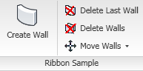
External Application
Getting Started
Implement Autodesk.Revit.IExternalApplication interface
Implement OnStartup() and OnShutdown() methods
public class App : IExternalApplication
{
public IExternalApplication.Result
OnStartup( ControlledApplication application )
{
CreateRibbonSamplePanel(application);
CreateRibbonInfosPanel(application);
return IExternalApplication.Result.Succeeded;
}
public IExternalApplication.Result
OnShutdown( ControlledApplication application )
{
return IExternalApplication.Result.Succeeded;
}
}
OnStartup() adds UI elements, hooks them up to external commands, event handlers
Can add panels containing separators, push and pulldown buttons
See Ribbon SDK sample
Notes:
An external application also appear in the add-ins tab. It can create its own panels. The objects are hooked up with external command implementations which are invoked and receive the same input and output parameters as normal external commands added to the external tools pulldown.

Slide 25
Modify Revit.ini for EA
Getting Started
Input similar to the non-ui Revit.ini EC items
Complete class name including namespace
Full assembly path
[ExternalApplications]
EACount=3
EAClassName1=RvtMgdDbg.App
EAAssembly1=C:\Program Files\Autodesk Revit Architecture 2010\Program\RvtMgdDbg.dll
EAClassName2=RvtSamples.Application
EAAssembly2=C:\a\lib\revit\2010\SDK\Samples\RvtSamples\CS\RvtSamples.dll
EAClassName3=Revit.SDK.Samples.Ribbon.CS.RibbonSample
EAAssembly3=C:\a\lib\revit\2010\SDK\Samples\Ribbon\Ribbon.dll
Notes:
Once we have created the application, we need to make it known to Revit. This is achieved by adding some information to Revit.ini.

Slide 26
Getting Started
Getting Started
External commands: HelloRevit and HelloWorld
External applications: APIAppStartup, Toolbar
"Hello World" basic sample
Lab 1-1
What arguments are passed to the command?
What can the command return?
Lab 1-2
Effective use of the debugger
Setting up a debugging Revit project
Edit and Continue is currently broken
Notes:
Now we are ready for our “Hello World” demonstration. Here are some SDK samples and labs for getting started. Lab 1-1 demonstrates a minimal “Hello World” command. Lab 1-2 explores the command argument issues.

Slide 27
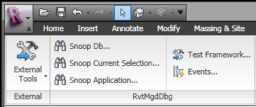
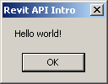
Minimal Command
Getting Started
Public Function Execute( _
ByVal commandData As Autodesk.Revit.ExternalCommandData, _
ByRef message As String, _
ByVal elements As Autodesk.Revit.ElementSet ) _
_
As Autodesk.Revit.IExternalCommand.Result _
Implements Autodesk.Revit.IExternalCommand.Execute
MsgBox("Hello World")
Return IExternalCommand.Result.Succeeded
End Function
In VB.NET
Notes:
You cannot get much more minimal than this.

Slide 28
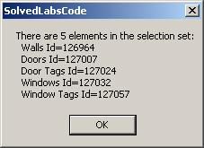
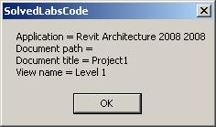
Command Input Argument
Getting Started
' List the app, doc and view data
Dim revitApp As Revit.Application = commandData.Application
Dim doc As Revit.Document = revitApp.ActiveDocument
Dim view As Revit.Elements.View = commandData.View
Dim sMsg As String = "Application = " & revitApp.VersionName & " " _
& revitApp.VersionNumber & vbCrLf
sMsg += "Document path = " & doc.PathName & vbCrLf ' Empty if not saved yet
sMsg += "Document title = " & doc.Title & vbCrLf
sMsg += "View name = " & view.Name
MsgBox(sMsg)
' List the current selection set
Dim sel As Selection = doc.Selection
sMsg = "There are " & sel.Elements.Size & " elements in the selection set:"
Dim elem As Revit.Element
For Each elem In sel.Elements
sMsg += vbCrLf & " " & elem.Category.Name & " Id=" & elem.Id.Value.ToString
Next
MsgBox(sMsg)
In VB.NET
Notes:
Display some application and document properties, retrieved from the command data input argument.

Slide 29
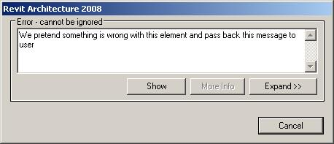
Command Output Arguments
Getting Started
' We pretend that something is wrong with the first element in the selection
' We pass the message back to Revit user and indicate the error result
If Not sel.Elements.IsEmpty Then
Dim iter As ElementSetIterator = sel.Elements.ForwardIterator
iter.MoveNext()
Dim errElem As Revit.Element = iter.Current
elements.Clear()
elements.Insert(errElem)
message = "We pretend something is wrong with this element and pass back this message to user"
Return IExternalCommand.Result.Failed
Else
Return IExternalCommand.Result.Succeeded
End If
Notes:
Check the document selection set contents. Return an error code to see the message displayed and the element highlighted. So, that is really all there is to say about the Revit add-in architecture, the external application and command interfaces, and their arguments. In the next section, we will start exploring the contents of the Revit database.

Slide 30
Application Installation
Getting Started
Installer will generally modify Revit.ini
Recommend placing application into Revit Program folder
Due to .NET framework restrictions, Load() versus LoadFrom()
MidasLink sample application includes setup source

Slide 31
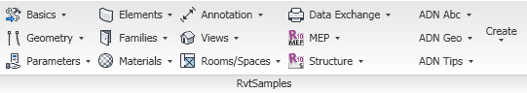
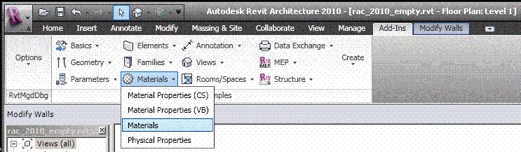
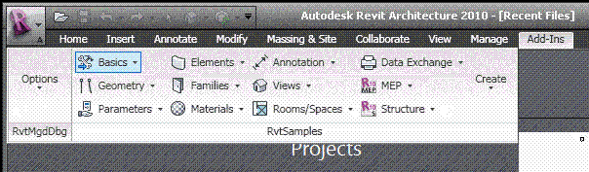
RvtSamples
Getting Started
So every external command needs to be added to Revit.ini?
Not using the SDK sample application RvtSamples!
Includes RvtSamples.txt listing all SDK samples
Adds them all to an own menu entry
Add six lines to Revit.ini and never touch it again
You can add your own entries to RvtSamples.txt
Also define own pulldown buttons for additional sections
Example
AdnSamples.txt
Provided with labs
Notes:
The RvtSamples application and RvtSamples.txt is included in the Revit SDK ... show contents on screen in explorer ... so, SDKSamples2010.sln provides accesss to search and debug all sample source code, and RvtSamples enables running every single sample

Slide 32
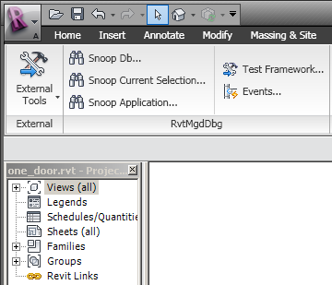
RvtMgdDbg
Getting Started
Available from ADN web site, search for "RvtMgdDbg"
Interactively access and explore entire database structure
Elements, parameters, relationships
Comprehensive Revit API test
Sample code and utility classes
Scaffolding for quick tests
Explore
Application
Document
Current selection
Reflection
Events
Tests
Notes:
RvtMgdDbg is a utility similar to the well-known ArxDbg and MgdDbg utilities provided for AutoCAD, written by the same author and his team. It is a Revit extension application which defines its own ribbon panel. It is available as a separate download from the ADN web site.

Slide 33
Hands On
Getting Started
Install SDK
Look at Revit API documentation
Run through Hello World sample
New class library solution
Reference RevitAPI.dll
IExternalCommand implementation
Edit Revit.ini
Debug
RvtMgdDbg
Compile and Install SDK Samples
Update references with RevitAPIDllPathUpdater.exe
Open SDKSamples2010.sln
Compile SDK samples
RvtSamples
Edit RvtSamples.txt

Slide 34
Database and Elements
Analyse the contents of the Revit database.
Iterate and filter for specific elements.
Make use of RvtMgdDbg.
Notes:
Now that we understand how to create the bare bones of our add-in and how it sets up its initial communication with the Revit application, let us explore and analyse the contents of the Revit database.

Slide 35
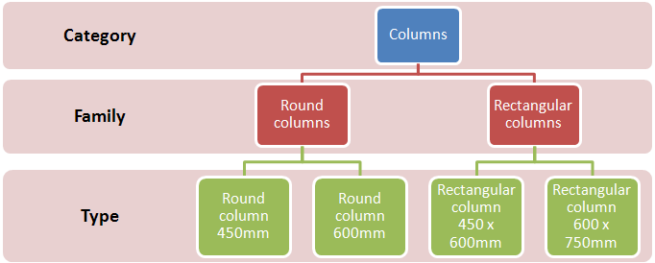
Category, Family, Type and Instance
Elements Collection
Revit Building Element
Category
Family: standard loadable, system, and in-place
Type
Instance
Notes:
Element: When creating a project, you add Revit MEP parametric building elements to the design. Revit MEP classifies elements by categories, families, and types.
Category: A category is a group of elements that you use to model or document a building design. For example, categories of model elements include mechanical equipment and air terminals. Categories of annotation elements include tags and symbols.
Family: Families are classes of elements in a category. A family groups elements with a common set of parameters (properties), identical use, and similar graphical representation. Different elements in a family may have different values for some or all properties, but the set of properties—their names and meaning—is the same. For example, a lighting fixture could be considered one family, although the pendant lights that compose the family come in different sizes and materials.
There are 3 kinds of families:
Loadable families can be loaded into a project and created from family templates. You can determine the set of properties and the graphical representation of the family.
System families include ducts, pipes, and wires. They are not available for loading or creating as separate files.
Revit MEP predefines the set of properties and the graphical representation of system families.
You can use the predefined types to generate new types that belong to this family within the project. For example, the behavior of a plumbing fitting is predefined in the system. However, you can create different types of fittings with different compositions.
System families can be transferred between projects.
In-place families are custom families that you create in the context of a project. Create an in-place family when your project needs unique geometry that you do not expect to reuse or geometry that must maintain one of more relationships to other project geometry.
Because in-place families are intended for limited use in a project, each in-place family contains only a single type. You can create multiple in-place families in your projects, and you can place copies of the same in-place family element in your projects. Unlike system and standard component families, you cannot duplicate in-place family types to create multiple types.
Type: Each family can have several types. A type can be a specific size of a family, such as a A0 title block. A type can also be a style, such as default aligned or default angular style for dimensions.
Instance: Instances are the actual items (individual elements) that are placed in the project and have specific locations in the design (model instances) or on a drawing sheet (annotation instances).

Slide 36
Elements Collection
Elements Collection
Object model
Database structure
Types of elements
Accessing and identifying elements
Filtering for types and categories
Getting all model elements
Model elements' manipulation
Notes:
We saw that the only input to the external command is the external command data argument. We will explore how to access the application, current document and their properties through this command data argument passed in to an external command. Then we will explore more detailed access to the Revit BIM and its data. The entire content of the Revit BIM is stored in a database and accessed through the Revit Document. Most of the objects are accessible through the document Elements collection property. Often, one is interested in elements of a particular type, so a common task is iterating over the elements collection and filtering for a specific type and/or property.

Slide 37
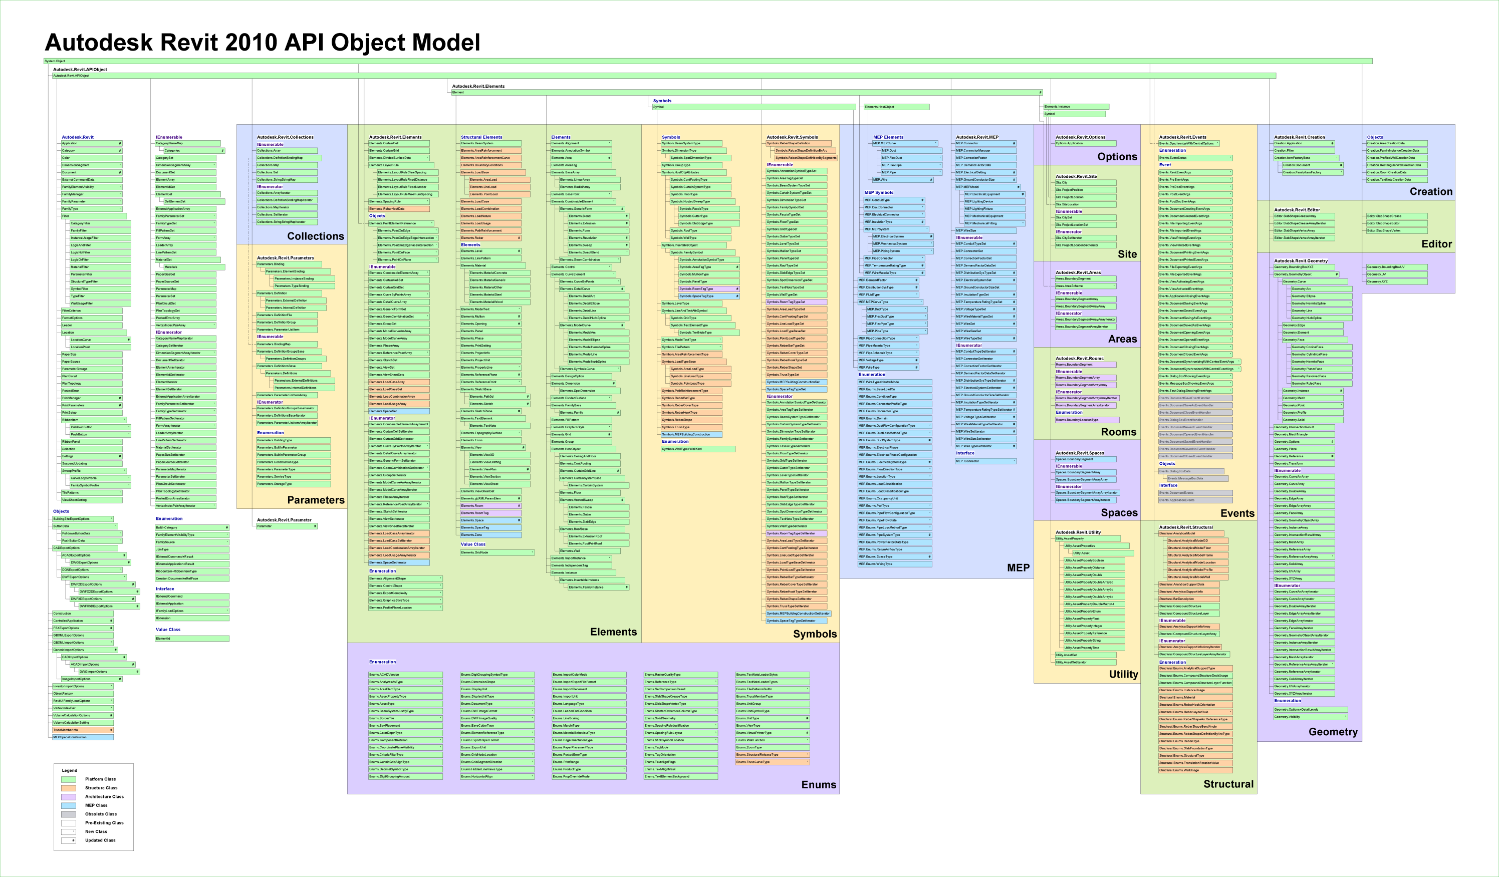
Revit Object Model
Elements Collection
Revit API Class Diagram.png
Notes:
Here is an overview of the Revit classes provided by the API. The model is rather large and unreadable at this scale. Let us look at a subset of interesting classes and highlight some of them.

Slide 38
Subset of Object Model
Elements Collection
APIObject
Application
Document
ExternalCommandData
ElementSet
ParameterSet
Parameter
Element
Symbol
GeometryObject
# RST:
AnalyticalModel
AnalyticalModelFloor
AnalyticalModelWall
Creation
APIObject
Application
Document
GeometryObject
Curve
Arc
Ellipse
Line
NurbSpline
Edge
Face
ConicalFace
CylindricalFace
HermiteFace
PlanarFace
ResolvedFace
RuldeFace
Instance
Mesh
Profile
Solid
Plane
Reference
Transform
Element
HostObject
CeilingAndFloor
ContFooting
Floor
Wall
Instance
Opening
TextElement
BeamSystem
Dimension
SpotDimension
FamilyBase
Family
Level
Phase
ProjectInfo
# RST:
BoundaryConditions
LoadCase, Combination, Nature, Usage
AreaReinforcement
AreaReinforcementCurve
LoadBase
AreaLoad
LineLoad
PointLoad
PathReinforcement
Rebar
# end of RST
Symbol
Symbol
AnnotationSymbolType
BeamSystemType
HostObjAttributes
ContFootingType
FloorType
WallType
InsertableObject
FamilySymbol
RoomTagType # RAC
RebarTagType # RST
Notes:
This is a subset selected from the Revit object model. Some of the interesting classes have been highlighted, and the list has been split into several sublists at crucial points. It shows that some objects are available only in the RAC or only in the RST environment, such as RoomTagType in RAC, RebarTagType, the analytical model and the loads and boundary conditions in RST. Everything is derived from APIObject. All physical BIM objects are derived from Element. A separate version of Application and Document is provided in the Creation namespace, for creating new elements.

Slide 39
Important Parent Classes
Elements Collection
APIObject – root object
Element – BIM elements
Symbol – type definition
GeometryObject – abstract geometry
Revit API Class Diagram.png shows full class hierarchy
Notes:
Here are some of the important tree nodes and parent classes in the Revit object model. Some objects are available only in the RAC or only in the RST environments, such as RoomTagType in RAC, RebarTagType, the analytical model and the loads and boundary conditions in RST.
Everything is derived from APIObject. All physical BIM objects are derived from Element. Geometry objects are in memory only, not stored in the database, created on the fly. A separate version of Application and Document is provided in the Creation namespace, for creating new elements.

Slide 40
Subsubset of Object Model
Elements Collection
API Object
Element
Family Base
Symbol
Group
Instance
HostObject
Family
Group Type
HostObject Attributes
Insertable Object
Insertable Instance
Wall
Floor
Family Symbol
Family Instance
Clg. & Flr
Wall Type
Floor Type
Cont. Footing Type
Cont. Footing
RoofBase
Families and types, aka symbols
Host and component objects, standard and system
Notes:
Here is a smaller subset of the most important database classes, i.e. non-geometrical classes, that appear in a typical Revit model programming task. The red classes are the most commonly used. The RoofBase class and its derived types FootPrintRoof and ExtrusionRoof were added in Revit 2009. In the model, we see the host and component objects, such as windows and doors. These are actually instances of types. The family base and family are used to manage collections of related types. Symbol is a base class for all types, also known as symbols. Family symbol is the generic class for these, whereas wall and floor type are more specialised classes. Family instance represents an occurrence or usage instance of a generic family symbol, whereas wall and floor represent the same for a wall or floor type.

Slide 41
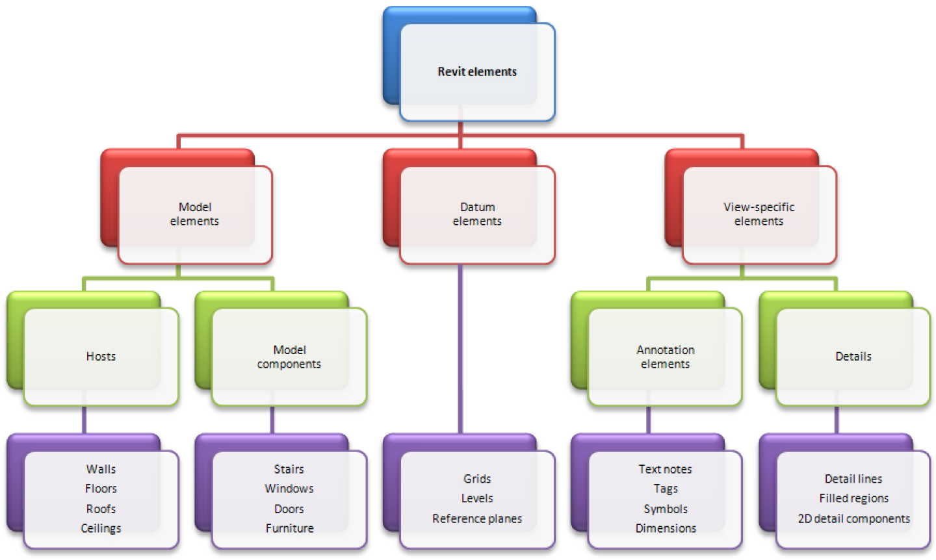
Some Visible Elements
Elements Collection
Notes:
Here is a classification of some of the typical visible elements in a model.
In projects, Revit uses 3 types of elements:
Model elements represent the actual 3D geometry of the building. They display in relevant views of the design. For example, sinks, boilers, ducts, sprinklers, and electrical panels.
Datum elements help to define project context. For example, grids, levels, and reference planes are datum elements.
View-specific elements display only in the views in which they are placed. They help to describe or document the design. For example, dimensions, tags, and 2D detail components are view-specific elements.
There are 2 types of model elements:
Hosts (or host elements) are generally built in place at the construction site. For example, walls and ceilings are hosts.
Model components are all the other types of elements in the building model. For example, sinks, boilers, ducts, sprinklers, and electrical panels.
There are 2 types of view-specific elements:
Annotation elements are 2D components that document the model and maintain scale on paper. For example, dimensions, tags, and keynotes are annotation elements.
Details are 2D items that provide details about the building model in a particular view. Examples include detail lines, filled regions, and 2D detail components.

Slide 42
Accessing Current Revit Element Selection
Elements Collection
Accesssing Revit data and elements in external command: selected or all
Use input argument ExternalCommandData
Current selection is member of document class
ExternalCommandData.Application.ActiveDocument.Selection.Elements
Document.Selection.Elements returns ElementSet collection
Use foreach, Size, Contains
Selection sel = doc.Selection;
string s = "There are " + sel.Elements.Size + " elements in the selection set:";
foreach( Element e in sel.Elements )
{
string cat = (null == e.Category) ? e.GetType().Name : e.Category.Name;
string desc = cat + " Id=" + e.Id.Value.ToString();
}
Application
ActiveDocument
Elements
Selection
Elements
Notes:
So, how do we access all these objects? We start off with the external command data argument passed in to the external command.

Slide 43
Accessing Revit Database Elements
Elements Collection
Document provides access to selected, all, or filtered elements
Three return argument types
ElementIterator it: use iterator.MoveNext(), iterator.Current()
ElementArray arr: use foreach, Size
List<Element> list: use foreach, Count, Contains
All
it = doc.Elements
Filtered
it = doc.Elements(Filter)
doc.Elements(Filter, arr)
doc.Elements(Filter, list)
Specified type
it = doc.Elements(Type)
doc.Elements(Type, arr)
doc.Elements(Type, list)
Application
ActiveDocument
Elements
Selection
Elements
Notes:
The Revit API makes use of generic collections and introduce optimised filtered element access in the 2009 version.

Slide 44
Elements Collection
Elements Collection
In the Revit API, everything is an APIObject
In the Revit BIM, everything is an Element
All are bundled together in the Elements collection
Search for ElementIterator and ElementFilterIterator in the SDK samples, and for get_Elements() in the labs
Lab 2-1
Notes:
ElementIterator and ElementFilterIterator occur in many of the SDK samples. The command defined in Lab 2-1 iterates over commandData.Application.ActiveDocument.Elements and prints out a line for each element encountered to C:\tmp\RevitElements.txt.

Slide 45
List all Elements
Elements Collection
// *ALL* elements are bundled together and accessible via Document's ElementIterator
string line;
Element elem;
ElementIterator iter = commandData.Application.ActiveDocument.Elements;
while( iter.MoveNext() )
{
elem = iter.Current as Element;
line = "Id=" + elem.Id.Value.ToString(); // Element Id
line += "; Class=" + elem.GetType().Name; // Element class (System.Type)
// Element Category, not implemented for all classes, may return null:
line += "; Category=" + ( null == elem.Category ? string.Empty : elem.Category.Name );
// Element Name (different meaning for different classes, but mostly implemented logically")
// Later, we'll see that more precise info on elements can be obtained in class-specific ways...
line += "; Name=" + elem.Name;
sw.WriteLine( line );
}
Id=16; Class=DimensionType; Category=; Name=Linear - 3mm Arial
Id=17; Class=Element; Category=; Name=
Id=19; Class=Element; Category=; Name=
Id=20; Class=FillPattern; Category=; Name=Solid fill
. . .
Id=126907; Class=Element; Category=; Name=M_W-Wide Flange
Id=126908; Class=Element; Category=; Name=W310X38.7
Id=126933; Class=Element; Category=; Name=Section Boxes
Id=126939; Class=Wall; Category=Walls; Name=Generic - 200mm
Notes:
Note that the result of this iteration is large. There are a lot of predefined elements and properties in the Revit database, even before we start adding our own. Once we have added a few elements, note that these are listed at the end, sequentially. From Revit 2009 onwards, you will probably seldom iterate over all elements, but use filtering to effectively pick out specific subsets instead. The element category is not implemented for all classes, it may return null; for Family elements, one can sometimes use the FamilyCategory property instead.

Slide 46
Identifying Revit Elements
Elements Collection
Normal OO approach uses object type or class
Identifying Revit elements can be brain twisting
An object can be identified by
Category
Object type or class, i.e. .NET System.Type
Specific parameter values
We use a combination of different criteria
Sometimes additional checks are needed
Many combinations can be encoded into the filtering mechanism which executes extremely efficiently
Notes:
The identification of elements and determining what type they have, or iterating the entire building model and extracting the specific instances that we are interested in, depends on the objects type. In some cases, we use standard object oriented techniques, simply querying their type or class. In others, we use the object category, which is a Revit API element property. Sometimes, a combination of the two is used, or additional parameters are queried.
More details on this are discussed in the separate presentation DE305-1 A Closer Look at the Database with the Revit API.

Slide 47
Identifying Revit Elements
Elements Collection
Kind of Element in UI | Derived from Element/TypeOf | Category
Wall | HostObject/Wall | Walls
Door | Instance/InsertableInstance/FamilyInstance | Doors
Door Tag | IndependentTag | Door Tags
Window | Instance/InsertableInstance/FamilyInstance | Windows
WindowTag | IndependentTag | Window Tags
Opening | Opening | Rectangular Straight Wall Opening
Floor | HostObject/Floor | Floors
Ceiling | Element | Ceilings
Roof | HostObject/RoofBase/FootPrintRoof, ExtrusionRoof | Roofs
Column | Instance/InsertableInstance/FamilyInstance | Columns
Component (Desk) | Instance/InsertableInstance/FamilyInstance | Furniture
Stair | Element | Stairs
Railing | Element | Railings
Room | Room | Rooms
Room Tag | RoomTag | Room Tags
Grid | Grid | Grids
Lines | ModelCurve/ModelLine | Lines
Ref Plane | ReferencePlane | Reference Planes
Dimension | Dimension | Dimensions
Section | Element | Views
Text | TextElement/TextNote | Text Notes
Level | Level | Levels
Model Group | Group | Model Group
Create…/Walls | Instance/InsertableInstance/FamilyInstance | Walls
Notes:
This table shows the list of Revit objects with their type (or class) and category. This was created after going through major objects using RvtMgdDbg tools. The column on the left is the object name displayed in the UI, the middle is the type or class, and on the right is the category. If you look at a wall object, for instance, you can see the type is Wall and category Walls. You can thus identify a wall object through its type alone. Looking at the Door and Window, You notice that their types are both FamilyInstance. From the type alone, you cannot tell if the family instance is a door or window. Their category is 'Doors' and 'Windows', and that can be used to identify them. Similarly, you will notice that columns and components such as furniture and desk are also family instance. Component family instances, which are defined by .rfa files, are all FamilyInstance elements. Objects with a designated type are all system families. Stairs and railings still are simply of type Element. This means that no dedicated derived type has been defined for them yet, i.e., still shows as element, this type of object is not completely exposed yet in the API. Notice the last line showing an in-place family for a wall. An in-place family instance has the same features as a family one.

Slide 48
Element versus Symbol
Elements Collection
Element |  |  |  | Symbol
Kind of Element in UI | Derived from Element/TypeOf | Category |  | Derived from Symbol/TypeOf | Category
Wall | HostObject/Wall | Walls |  | HostObjAttributes/WallType | Walls
Door | Instance/InsertableInstance/FamilyInstance | Doors |  | InsertableObject /FamilySymbol | Doors
Door Tag | IndependentTag | Door Tags |  | InsertableObject /FamilySymbol | Door Tags
Window | Instance/InsertableInstance/FamilyInstance | Windows |  | InsertableObject /FamilySymbol | Windows
WindowTag | IndependentTag | Window Tags |  | InsertableObject /FamilySymbol | Window Tags
Opening | Opening | Rectangular Straight Wall Opening |  | < null > | ---
Floor | HostObject/Floor | Floors |  | HostObjAttributes/FloorType | Floors
Ceiling | < Element > | Ceilings |  | HostObjAttributes | Ceilings
Roof | HostObject/RoofBase/FootPrintRoof,ExtrusionRoof | Roofs |  | HostObjAttributes/RoofType | Roofs
Column | Instance/InsertableInstance/FamilyInstance | Columns |  | InsertableObject /FamilySymbol | Columns
Component (Desk) | Instance/InsertableInstance/FamilyInstance | Furniture |  | InsertableObject /FamilySymbol | Furniture
Component (Tree) | Instance/InsertableInstance/FamilyInstance | Planting |  | InsertableObject /FamilySymbol | Planting
Stairs | < Element > | Stairs |  | < Symbol > | Staies
Railing | < Element > | Railings |  | < Symbol > | Railings
Room | Room | Rooms |  | < null > | ---
Room Tag | RoomTag | Room Tags |  | < Symbol > | Room Tags
Grid | Grid | Grids |  | LineAndTextAttrSymbol/GridType | < null >
Lines | ModelCurve/ModelLine | Lines |  | < null > | ---
Ref Plane | ReferencePlane | Reference Planes |  | < null > | ---
Dimension | Dimension | Dimensions |  | DimensionType | < null >
Section | < Element > | Views |  | < Symbol > | < null >
Text | TextElement/TextNote | Text Notes |  | LineAndTextAttrSymbol/TextElementType/TextNoteType | < null >
Level | Level | Levels |  | LevelType | Levels
Model Group | Group | Model Group |  | GroupType | Model Groups
Create…/Walls | Instance/InsertableInstance/FamilyInstance | Walls |  | InsertableObject /FamilySymbol | Walls
Notes:
The second table shows a similar list with the symbol type and its corresponding category added. The two columns on the right show the type and category of the symbol or family type used for each model elmeent, represented by a family or dedicated type instance. It shows the correspondence between the instance and symbol elements. The symbol used for a wall is WallType, floor uses FloorType, roof uses RoofType. For component families such as door, window, column, desk and tree, the symbol type is FamilySymbol. Again, in these cases you need to rely on the category to tell the different family symbols apart, while there are designed types for system families.

Slide 49
3D or Model Elements
Elements Collection
Often one is interested in 3D elements only
Predicates
Category is not null
Level is not null
Geometry is not null
Lab 2-2
Notes:
Lab 2-2 demonstrates how to extract all elements with a 3D geometry, i.e. visible objects like walls, doors, windows, furniture, etc. This lab iterates over the active document elements collection, like before, and picks out relevant ones. This is a common operation in Revit programming. The exact details of the selection criteria obviously depend on your specific needs.

Slide 50
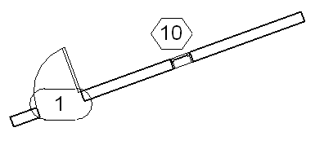
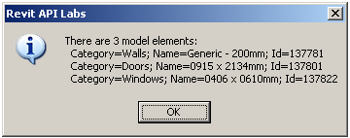
3D or Model Elements
Elements Collection
int count = 0;
ElementIterator it = app.ActiveDocument.Elements;
while( it.MoveNext() )
{
Element e = it.Current as Element;
if( (null != e.Category)
&& (null != e.Level)
&& (null != e.get_Geometry(opt)) )
{
++count;
s += string.Format( "\r\n Category={0}; Name={1}; Id={2}",
e.Category.Name, e.Name, e.Id.Value.ToString() );
}
}
s = "There are " + count.ToString() + " model elements:" + s;
LabUtils.InfoMsg( s );

Slide 51
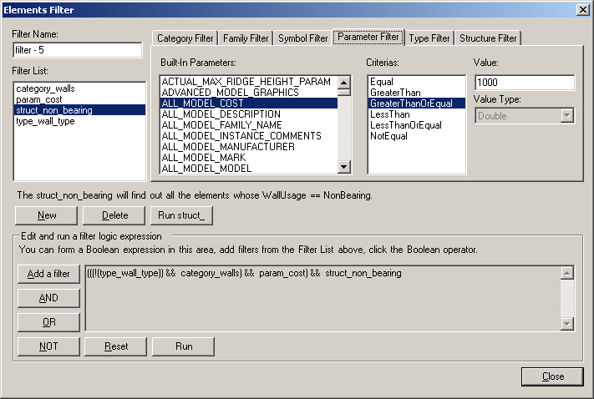
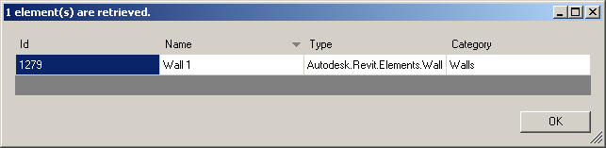
Element Filtering
Elements Collection
Retrieve elements from database using atomic filters
Category name, built-in category, family name, symbol name, type, structural classification, parameter value eq, gt, ge, lt, le, ne
Boolean combinations of atomic filters
And, or, not
SDK sample ElementsFilter
Demonstrates how to use
Provides testing framework
Speed improvement
An order of magnitude
E.g. 210 seconds down to 2.1
Notes:
The Revit element filtering provides filtered access to elements. Several different types of filters are available. Filters can be atomic, based on category name, built-in category, family name, symbol name, type, structural classification, or parameter value. When searching for elements based on parameter value, the comparison criterion can be specified as equal, gt, ge, lt, le, ne, etc. The execution speed of the new element filtering is significantly higher than the element iteration in previous versions. All aspects of the functionality are demonstrated by the new SDK sample application ElementsFilter.

Slide 52
C# Element Filtering Comparison
Elements Collection
Without filtering
public static ElementSet GetAllWalls_noFilter( Application app )
{
ElementSet elems = app.Create.NewElementSet();
ElementIterator iter = app.ActiveDocument.Elements;
while( iter.MoveNext() )
{
Element elem = iter.Current as Element;
if( elem is Wall )
{
elems.Insert( elem );
}
}
return elems;
}
With filtering
public static List<Element> GetAllWalls( Application app )
{
List<Element> elements = new List<Element>();
Filter filterType = app.Create.Filter.NewTypeFilter( typeof( Wall ) );
app.ActiveDocument.get_Elements( filterType, elements );
return elements;
}
Notes:
Here is a very simple example of using the new filtering feature, selecting all walls from the Revit database. In 2008, one would have used a loop to pick out the walls from the collection of all document elements. In 2009, using filtering, this method is more concise, no loop is required, and only wall elements are returned.

Slide 53
VB Element Filtering Comparison
Elements Collection
Without filtering
Shared Function GetAllWalls_noFilter(ByVal app As Revit.Application) As ElementSet
Dim elems As ElementSet = app.Create.NewElementSet
Dim iter As IEnumerator = app.ActiveDocument.Elements
Do While (iter.MoveNext())
Dim elem As Revit.Element = iter.Current
If TypeOf elem Is Wall Then
elems.Insert(elem)
End If
Loop
Return elems
End Function
With filtering
Shared Function GetAllWalls(ByVal app As Revit.Application) As List(Of Element)
Dim elements As New List(Of Element)
Dim filterType As Filter = app.Create.Filter.NewTypeFilter(GetType(Wall))
Dim n As Integer = app.ActiveDocument.Elements(filterType, elements)
Return elements
End Function
Notes:
Here is the same example in VB syntax.

Slide 54
Boolean Element Filtering Example
Elements Collection
C#
public static List<Element> GetAllModelGroupTypes( Application app )
{
List<Element> elements = new List<Element>();
Filter filterType = app.Create.Filter.NewTypeFilter( typeof( GroupType ) );
Filter filterParam = app.Create.Filter.NewParameterFilter(
BuiltInParameter.SYMBOL_FAMILY_NAME_PARAM, CriteriaFilterType.Equal,
"Model Group" );
Filter filterAnd = app.Create.Filter.NewLogicAndFilter( filterType, filterParam );
app.ActiveDocument.get_Elements( filterAnd, elements );
return elements;
}
VB
Shared Function GetAllModelGroupTypes(ByVal app As Revit.Application) As List(Of Element)
Dim elements As New List(Of Element)
Dim filterType As Filter = app.Create.Filter.NewTypeFilter(GetType(GroupType))
Dim filterParam = app.Create.Filter.NewParameterFilter( _
BuiltInParameter.SYMBOL_FAMILY_NAME_PARAM, _
CriteriaFilterType.Equal, "Model Group")
Dim filter As Filter = app.Create.Filter.NewLogicAndFilter(filterType, filterParam)
Dim n As Integer = app.ActiveDocument.Elements(filter, elements)
Return elements
End Function
Notes:
Here is a slightly more complex example, which includes filtering for a specific parameter value. Here we are selecting all model group types in the database. In 2008, this involves iterating over all elements, selecting GroupType objects, and then checking a parameter for a specific value. In 2009, this can all be achieved more concisely and efficiently using filtering, by combining a type and a parameter filter with a Boolean and filter.

Slide 55
Specific Element Classes
Elements Collection
How do we get e.g. all Doors or Walls?
Wall is a separate class
APIObject ← Element ← HostObject ← Wall
(An in-place family wall is a FamilyInstance)
Filter for Wall System.Type
Door can be identified by its category
System.Type is a generic FamilyInstance
Use BuiltInCategory enum for language independence
Filter for FamilyInstance System.Type and door category
Lab 2-3
Notes:
Lab 2-3 extracts walls by checking for each element for its class, and doors by checking its category. This is similar to Lab 2-2, but now we check for a an even more specific type or a built-in category.

Slide 56
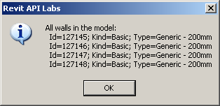
Get all Walls
Elements Collection
public static List<Element> GetAllWalls( Application app )
{
List<Element> elements = new List<Element>();
Filter filterType = app.Create.Filter.NewTypeFilter( typeof( Wall ) );
app.ActiveDocument.get_Elements( filterType, elements );
return elements;
}

Slide 57
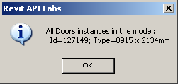
Get all Doors
Elements Collection
public static List<Element> GetAllStandardFamilyInstancesForACategory(
Application app,
BuiltInCategory bic )
{
List<Element> elements = new List<Element>();
Filter filterType = app.Create.Filter.NewTypeFilter( typeof( FamilyInstance ) );
Filter filterCategory = app.Create.Filter.NewCategoryFilter( bic );
Filter filterAnd = app.Create.Filter.NewLogicAndFilter( filterType, filterCategory );
app.ActiveDocument.get_Elements( filterAnd, elements );
return elements;
}

Slide 58
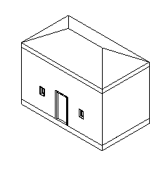
Adding Elements
Elements Collection
Adding
Over 120 methods defined by Autodesk.Revit.Creation.Document
Over 40 object types supported
e.g. Walls, Floors
NewWall( CurveArray profile, bool structural ); // + 4 overloads
NewSlab( CurveArray profile, Level, Line slopedArrow, double angle, bool isImperial, bool isStructural );
Still some objects missing ...
Lab 2-0
Deleting
Revit SDK Samples DeleteDimensions, DeleteObject

Slide 59
Element manipulation
Elements Collection
Select a wall
Extract wall from current selection
Obtain wall top and bottom level constraints
Calculate geometry from levels and wall curve
Obtain family symbol for column type
Insert columns at start, mid and end
Move wall away from the columns
Lab 2-4
Prerequisites
Wall constrained at top
"M_Wood Timber Column" type loaded
Notes:
To run Lab 2-4, select a wall. It must be constrained to a level at the top: Element Properties... > Constraints > Top Constraint, otherwise an error message is displayed. Load the column family named "M_Wood Timber Column" and the type named "191 x 292mm" prior to running the command, or else highlight the error message displayed, or modify the names to refer to some family type that is loaded. The selected wall is used to define three columns at its end and mid points, then the wall is moved out of the way to clearly display the columns.

Slide 60
Selecting the Wall
Elements Collection
Dim doc As Revit.Document = commandData.Application.ActiveDocument
Dim ss As ElementSet = doc.Selection.Elements
' must have single element only
If Not ss.Size = 1 Then
MsgBox( "You must pre-select a single element!" )
Return IExternalCommand.Result.Cancelled
End If
' must be a wall
Dim iter As ElementSetIterator = ss.ForwardIterator
iter.MoveNext()
Dim elem As Revit.Element = iter.Current
If Not TypeOf elem Is Wall Then
MsgBox( "Selected element is NOT a wall!" )
Return IExternalCommand.Result.Cancelled
End If
Dim wall As Wall = elem

Slide 61
Wall Top and Bottom
Elements Collection
' wall must be constrained to a Level at the top (more on Parameters later...)
Dim topLev As Level = Nothing
Try
topLev = doc.Element(wall.Parameter(BuiltInParameter.WALL_HEIGHT_TYPE).AsElementId)
Catch
topLev = Nothing
End Try
If topLev Is Nothing Then
MsgBox( "Selected Wall is NOT constrained to a Level at the Top!" )
Return IExternalCommand.Result.Cancelled
End If
' get the bottom Level as well (this should never fail)
Dim botLev As Level = Nothing
Try
botLev = doc.Element(wall.Parameter(BuiltInParameter.WALL_BASE_CONSTRAINT).AsElementId)
Catch
botLev = Nothing
End Try
If botLev Is Nothing Then
MsgBox( "Selected Wall is NOT constrained to a Level at the Bottom?!" )
Return IExternalCommand.Result.Cancelled
End If

Slide 62
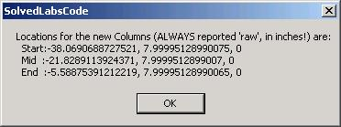
Column Geometry
Elements Collection
' Calculate the location points for the 3 columns (assuming straight wall)
Dim locations As New XYZArray()
Dim locCurve As LocationCurve = wall.Location
Dim pStart As XYZ = locCurve.Curve.EndPoint(0)
Dim pEnd As XYZ = locCurve.Curve.EndPoint(1)
Dim ptMid As New XYZ((pStart.X + pEnd.X) / 2, (pStart.Y + pEnd.Y) / 2, (pStart.Z + pEnd.Z) / 2)
locations.Append(pStart)
locations.Append(ptMid)
locations.Append(pEnd)
Dim sMsg As String = "Locations for the new Columns (ALWAYS reported 'raw', in inches!) are:"
sMsg += vbCrLf & " Start:" & pStart.X & ", " & pStart.Y & ", " & pStart.Z
sMsg += vbCrLf & " Mid :" & ptMid.X & ", " & ptMid.Y & ", " & ptMid.Z
sMsg += vbCrLf & " End :" & pEnd.X & ", " & pEnd.Y & ", " & pEnd.Z
MsgBox(sMsg)

Slide 63
Column Type
Elements Collection
/// Helper to get specified Type for specified Family as FamilySymbol object
public static FamilySymbol GetFamilySymbol(
Application app,
string familyName,
string typeName )
{
Filter filterType = app.Create.Filter.NewTypeFilter( typeof( FamilySymbol ) );
Filter filterFamilyName = app.Create.Filter.NewFamilyFilter( familyName );
Filter filter = app.Create.Filter.NewLogicAndFilter( filterType, filterFamilyName );
List<Element> elementList = new List<Element>();
int n = app.ActiveDocument.get_Elements( filter, elementList );
// we have a list of symbols for a given family.
// loop through the list and find a match
foreach( Element e in elementList )
{
if( e.Name.Equals( typeName ) )
{
return e as FamilySymbol;
}
}
return null;
}
' Get Family Type for the new instances.
' Names must match a column type available in the model
Dim sFamilyName As String = "M_Wood Timber Column"
Dim sTypeName As String = "191 x 292mm"
Dim symbol As FamilySymbol = LabUtils.GetFamilySymbol( _
doc, sFamilyName, sTypeName)
If symbol Is Nothing Then
MsgBox("Cannot find Family=" & sFamilyName & " Type=" & sTypeName _
& " in the model - load it first!")
Return IExternalCommand.Result.Cancelled
End If
Notes:
The GetFamilySymbol() helper method iterates over all elements and searches for the named family. Within that family’s symbols, it searches for the named type and returns that element instance.

Slide 64
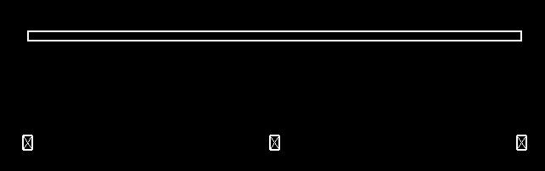
Insert Column and Move Wall
Elements Collection
' Insert Columns as FamilyInstances
Dim pt As XYZ
For Each pt In locations
Try
Dim column As FamilyInstance = doc.Create.NewFamilyInstance(pt, symbol, botLev, Structural.Enums.StructuralType.NonStuctural)
Dim paramTopLevel As Parameter =
column.Parameter(BuiltInParameter.FAMILY_TOP_LEVEL_PARAM)
paramTopLevel.Set(topLev.Id)
Catch e As Exception
MsgBox("Failed to create or adjust this column!?")
End Try
Next
' Finally, move the wall so the columns are surely visible. For simplicity,
' move the wall "perpendicularly" to the Location curve by its length
Dim wallPerpAxis As New XYZ(-(pEnd.Y - pStart.Y), pEnd.X - pStart.X, 0)
If Not CType(wall.Location.Move(wallPerpAxis), Boolean) Then
MsgBox("Failed to Move the wall!?")
End If

Slide 65
Categories
Elements Collection
List all built-in categories and the entire category tree
Not all built-in categories have a corresponding document category
Not all document categories have a corresponding built-in category
There are more than 600 built-in categories
More than two thirds of them have associated document categories
About 200 of these are top level parents
These lead to more than 400 top-level and children categories
Lab 2-5

Slide 66
Families and Types
Notes:
As we saw above, many visible objects in the Revit BIM are instances of symbols or types. These types are grouped into families. Each family defines a number of symbols or types. When an element is inserted into the model, the user specifies which family it belongs to, and which specific type it has, so the inserted object is an instance of this family and type. If it is a component family, its class is FamilyInstance. In this section, we discuss the management of families and types.

Slide 67
Families and Types
Families and Types
Also know as symbols
Standard versus system families
Using loaded families and symbols
Loading new families and symbols
Determining and changing element's type
Standard and system families
Notes:
In order to insert the column in the last example, we already had the need to determine a suitable family type for it. If the family or that specific type was not available, we had to prompt the user to load it manually. This procedure can be automated. In this section, we explore the handling of families and types in more detail. There are two types of families: standard ones, which are stored in external Revit family files with the extension *.rfa, and built-in system families.

Slide 68
Listing Families and Types
Families and Types
One will frequently need to determine
Which standard families and symbols are loaded in a model
Which category do they belong to
Lab 3-1

Slide 69
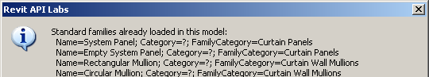
Family Iteration
Families and Types
List<Element> families = new List<Element>();
Filter filterFamily = app.Create.Filter.NewTypeFilter( typeof( Family ) );
doc.get_Elements( filterFamily, families );
string sMsg = "Standard families already loaded in this model:";
foreach( Family f in families )
{
// Get its category name; notice that the Category property is not
// implemented for the Family class; use FamilyCategory instead;
// notice that that is also not always implemented; in that case,
// use the workaround demonstrated below, looking at the contained
// family symbols' category:
sMsg += "\r\n Name=" + f.Name
+ "; Category=" + ( ( null == f.Category ) ? "?" : f.Category.Name )
+ "; FamilyCategory=" + ( ( null == f.FamilyCategory ) ? "?" : f.FamilyCategory.Name );
}
LabUtils.InfoMsg( sMsg );
The Category property is always unimplemented
The FamilyCategory is sometimes unimplemented
Notes:
We iterate over the document elements in two loops. In the first, we simple determine all the families. The Category property is NOT implemented for the Family class. Therefore, in the second loop, we retrieve and list all the symbols of each family, and retrieve the family category from the first of its symbols.

Slide 70
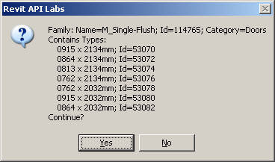
Family Symbol Iteration
Families and Types
// Loop through the collection of families, and now look at
// the child symbols (types) as well. These symbols can be
// used to determine the family category.
foreach( Family f in families )
{
string catName;
bool first = true;
// Loop all contained symbols (types)
foreach( FamilySymbol symb in f.Symbols )
{
// you can determine the family category
// from its first symbol.
if( first )
{
first = false;
catName = symb.Category.Name;
sMsg = "Family: Name=" + f.Name
+ "; Id=" + f.Id.Value.ToString()
+ "; Category=" + catName
+ "\r\nContains Types:";
}
sMsg += "\r\n " + symb.Name + "; Id=" + symb.Id.Value.ToString();
}
// Show the symbols for this family and allow user to proceed
// to the next family (OK) or cancel (Cancel)
sMsg += "\r\nContinue?";
if( !LabUtils.QuestionMsg( sMsg ) )
{
break;
}
}
Notes:
Here, in the second loop, we retrieve and list all the symbols of each family, and retrieve the family category from the first of its symbols. We can cancel out of this loop once we have seen enough.

Slide 71
Loading Families and Types
Families and Types
Load additional standard families and symbols from RFA files
doc.LoadFamily()
doc.LoadFamilySymbol()
Dim doc As Revit.Document = commandData.Application.ActiveDocument
'Load a whole Family
If Not CType(doc.LoadFamily(familyFilename), Boolean) Then
MsgBox( "ERROR in loading Family " & familyFilename & "?" )
Else
MsgBox( "Successfully loaded Family " & familyFilename & "!" )
End If
'Load only a specific Symbol (Type)
' The symbol MUST exist in the corresponding catalog (TXT) file - same as in the UI
If Not CType(doc.LoadFamilySymbol(familyFilename, symbolName), Boolean) Then
MsgBox( "ERROR in loading FamilySymbol " & familyFilename & " : " & symbolName & "?" )
Else
MsgBox( "Successfully loaded FamilySymbol " & familyFilename & " : " & symbolName & "!" )
End If
Lab 3-2
Notes:
This is demonstrated in Lab 3-2. This lab loads an entire family and a single symbol from another family, determined by the global variables gsWholeFamilyFileToLoad1, gsWholeFamilyFileToLoad2, gsFamilyFileToLoadSingleSymbol, gsSymbolName.

Slide 72
Determining Standard Family and Type
Families and Types
Determine the standard family and type of an element
Select a window
List all windows symbols
List the selected window’s family symbol and family
Lab 3-3
Notes:
Lab 3-3 shows how to determine the Family and Type of an element, and how to list all the symbols applicable to a specific category, such as Windows.
Before running this command, create a wall with a window in it and select the window. First of all, all the loaded window types are determined, i.e. all the symbols defined by the window family. This is done by iterating over all elements and determining all FamilySymbol instances whose category equals the windows one. Secondly, the selected window's family symbol and from that the family itself is queried and displayed.

Slide 73
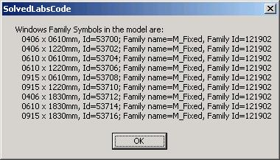
List Window Symbols
Families and Types
BuiltInCategory bic = BuiltInCategory.OST_Windows;
Filter filterCategory = app.Create.Filter.NewCategoryFilter( bic );
Filter filterType = app.Create.Filter.NewTypeFilter( typeof( FamilySymbol ) );
Filter filterAnd = app.Create.Filter.NewLogicAndFilter( filterCategory, filterType );
List<Element> familySymbols = new List<Element>();
app.ActiveDocument.get_Elements( filterAnd, familySymbols );
string sMsg = "The loaded windows family symbols in the model are:";
foreach( Element e in familySymbols )
{
FamilySymbol symb = e as FamilySymbol;
sMsg += "\r\n " + symb.Name + ", Id=" + symb.Id.Value.ToString();
Family fam = symb.Family;
sMsg += "; Family name=" + fam.Name + ", Family Id=" + fam.Id.Value.ToString();
}
Notes:
Here is an example of determining all the loaded window types, i.e. all the symbols defined by the window family. This is done by iterating over all elements and determining all FamilySymbol instances whose category equals the windows one.
Note that the category can be checked and compared in several different ways. In general, the best way is to make use of the language independent BuiltInCategory enumeration and avoid using the language dependent Name property for comparison, since the category objects themselves can be compared directly.

Slide 74
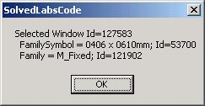
Get Family and Symbol
Families and Types
' Now loop the selection set and check for standard
' Family Instances of "Windows" category
For Each elem In doc.Selection.Elements
If TypeOf elem Is FamilyInstance Then
Dim inst As FamilyInstance = elem
Dim catInst As Category = Nothing
Try ' just in case
catInst = inst.Category
Catch
End Try
If (Not catInst Is Nothing) AndAlso catInst.Equals(catWindows) Then
sMsg = "Selected Window Id=" & elem.Id.Value.ToString & vbCrLf
Dim fs1 As FamilySymbol = inst.Symbol
sMsg += " FamilySymbol = " & fs1.Name & "; Id=" _
& fs1.Id.Value.ToString & vbCrLf
Dim f1 As Family = fs1.Family
sMsg += " Family = " & f1.Name & "; Id=" & f1.Id.Value.ToString
End If
End If
' Report each Window data
MsgBox(sMsg)
Next
Notes:
We can query and display the selected window's family symbol and from that the family itself. The family and symbol assigned to a specific family instance are available as properties on the given element and its symbol. For instance, to determine a selected window’s family and type, we read the Symbol property of the given element and its symbol’s Family property.

Slide 75
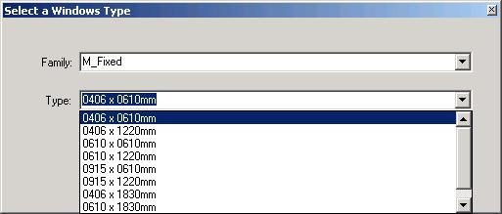
Change Family Instance Type
Families and Types
A simple dialog to change the type of a family instance
Determine family instance category, e.g. Windows
Assemble a list of all applicable symbols
Iterate over all elements, check each family category
If it matches, include all its symbols
Display dialogue with list box
Assign selected symbol
Lab 3-4
Notes:
The family type of a family instance can also be changed by modifying its Symbol property. Before running this command, create a wall with a window in it, load some additional window families so there is some material to play with, and select the window. Any other symbol instance can also be selected. First the selected symbol instance category is determined. From that, a list of all other applicable types is determined by iterating over all elements and assembling a dictionary of them. This is a two-step process, identifying the matching families first, and then for each matching family adding all its symbols. With this information in place, a dialogue is displayed allowing the user to select any one of the applicable symbols. If one is selected, it is applied to the selected instance, changing its symbol.

Slide 76
Determine Selected Instance Category
Families and Types
Dim inst As FamilyInstance
Dim instCat As Category
Dim ss As ElementSet = doc.Selection.Elements
' Make sure we have a single FamilyInstance selected
If Not ss.Size = 1 Then
MsgBox("You must pre-select a single element!")
Return IExternalCommand.Result.Cancelled
Else
Dim itTmp As ElementSetIterator = ss.ForwardIterator
itTmp.MoveNext()
Dim elTmp As Revit.Element = itTmp.Current
If Not TypeOf elTmp Is FamilyInstance Then
MsgBox("Selected element is NOT a standard family instance!")
Return IExternalCommand.Result.Cancelled
Else
inst = elTmp
instCat = inst.Category
End If
End If
Notes:
We ensure a single element is selected, that it is a family instance, and determine its category.

Slide 77
List all Symbols for Category
Families and Types
Dim dictFamilyToSymbols As New Dictionary(Of String, ArrayList)
' using element filtering
Dim families As List(Of Revit.Element) = New List(Of Revit.Element)
Dim filter As Revit.Filter = app.Create.Filter.NewTypeFilter(GetType(Family))
Dim nRetVal = doc.Elements(filter, families)
Dim f As Family
Dim categoryMatches = False
For Each f In families
categoryMatches = False
If (f.FamilyCategory Is Nothing) Then ' not always implemented
For Each sym As FamilySymbol In f.Symbols _
categoryMatches = sym.Category.Id.Equals(instCat.Id)
Exit For
Next
Else
categoryMatches = f.FamilyCategory.Id.Equals(instCat.Id)
End If
If (categoryMatches) Then
Dim familySymbols As New ArrayList
For Each sym As FamilySymbol In f.Symbols
familySymbols.Add(sym)
Next
dictFamilyToSymbols.Add(f.Name, familySymbols)
End If
Next
Notes:
For the selected symbol instance category, a list of all applicable types is determined by iterating over all elements and assembling a dictionary of them. There are many ways how to store the matching objects, but we choose whatever is most suitable for the relevant UI: We could use Revit's generic Map class, but it is probably more efficient to use the .NET strongly-typed Dictionary with KEY = Family name (String) and VALUE = ArrayList (implements iList so we can elegantly bind it to combobox) of corresponding FamilySymbol obects. This is a two-step process, identifying the matching families first, and then for each matching family adding all its symbols. With this information in place, a dialogue is displayed allowing the user to select any one of the applicable symbols. If one is selected, it is applied to the selected instance, changing its symbol.

Slide 78
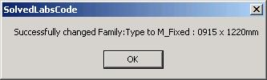
Assign new Type
Families and Types
' Display the form and change the type
Dim frm As New Lab3_4_Form(dictFamilyToSymbols)
If frm.ShowDialog = Windows.Forms.DialogResult.OK Then
Try
inst.Symbol = frm.cmbType.SelectedItem
MsgBox("Successfully changed Family:Type to " _
& frm.cmbFamily.Text & " : " & frm.cmbType.Text)
Catch
End Try
End If
Notes:
With this information in place, a dialogue is displayed allowing the user to select any one of the applicable symbols.
If one is selected, it is applied to the selected instance, changing its symbol.

Slide 79
System Families and Types
Families and Types
Dedicated classes rather than generic standard ones
Typically derived from HostObject
Wall, Floor, RoofBase, FootPrintRoof and ExtrusionRoof
Corresponding types are derived from HostObjAttributes
Accessible from Document class
Wall – WallTypes
Floor – FloorTypes
Roof – RoofTypes
Lab 3-5
List all Wall types, save last one, use Document property WallTypes
List all Floor types, save last one, use Document.FloorTypes
Change all selected walls' and floors' type
Notes:
Above, we discussed listing and manipulating standard families and types and family instances. Similar principles apply when working with system families.
Before running this command, draw four walls and a floor and select them all. First, all wall types defined in the current document are listed and the last one is stored for later use. Then all floor types including foundations (slab) defined in the current document are listed and the last one is stored for later use. Finally, all the selected wall and floor types are changed to the stored ones.

Slide 80
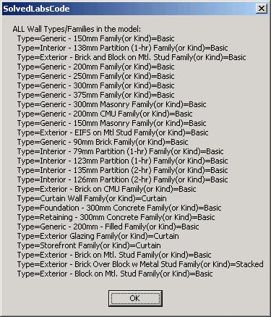
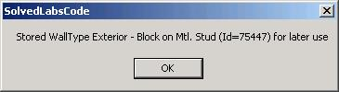
List all Wall Types
Families and Types
' Find ALL Wall Types and their System Families (or Kinds)
Dim newWallType As WallType = Nothing ' store the last one
Dim sMsg As String = "ALL Wall Types/Families in the model:"
' We could again iterete all elements and check for WallType class,
' but it's simpler directly from the doc:
Dim doc As Revit.Document = commandData.Application.ActiveDocument
For Each wt As WallType In doc.WallTypes
sMsg += vbCrLf & " Type=" & wt.Name & " Family(or Kind)=" & wt.Kind.ToString
newWallType = wt
Next
MsgBox(sMsg)
MsgBox( "Stored WallType " & newWallType.Name _
& " (Id=" & newWallType.Id.Value.ToString & ") for later use" )
Notes:
All wall types defined in the current document are listed and the last one is stored for later use.

Slide 81
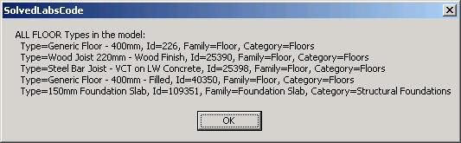
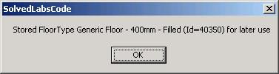
List all Floor Types
Families and Types
' Find ALL Floor Types ... see updated code and more comments in Labs code
Dim newFloorType As FloorType = Nothing ' at the same time store the last one to use to change the floor type later
sMsg = "ALL FLOOR Types in the model:"
' There is no dedicated property to get floor types, so need to iterate all elements again
Dim iter As ElementIterator = doc.Elements
Do While (iter.MoveNext())
Dim elem As Revit.Element = iter.Current
If TypeOf elem Is Symbols.FloorType Then
Dim ft As Symbols.FloorType = elem
sMsg += vbCrLf & " Type=" & ft.Name & ", Id=" & ft.Id.Value.ToString
' In 9.0, it looks like "Foundation Slab" system family from "Structural Foundations" category
' ALSO contains FloorType class instances. Exclude those as choices for standard floor types
Dim famName As String
Try
famName = ft.Parameter(Parameters.BuiltInParameter.SYMBOL_FAMILY_NAME_PARAM).AsString
Catch
famName = "?"
End Try
Dim cat As Category = ft.Category
sMsg += ", Family=" & famName & ", Category=" & cat.Name
' store only if proper Floors category
If doc.Settings.Categories.Item(BuiltInCategory.OST_Floors).Equals(cat) Then
newFloorType = ft
End If
End If
Loop
MsgBox(sMsg)
MsgBox( "Stored FloorType " & newFloorType.Name & " (Id=" & newFloorType.Id.Value.ToString & ") for later use")
Notes:
All floor types including foundations (slab) defined in the current document are listed and the last one is stored for later use.

Slide 82
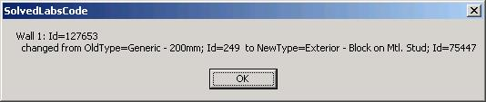
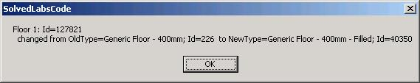
Change Wall and Floor Type
Families and Types
' Change the Type for selected Walls and Floors
Dim sel As ElementSet = doc.Selection.Elements
Dim iWall As Integer
Dim el As Revit.Element
For Each el In sel
If TypeOf el Is Wall Then ' Check for walls
Dim wall As Wall = el
iWall += 1
Dim oldWallType As WallType = wall.WallType
wall.WallType = newWallType
MsgBox("Wall " & iWall.ToString & ": Id=" & wall.Id.Value.ToString & vbCrLf & _
" changed from OldType=" & oldWallType.Name & "; Id=" & oldWallType.Id.Value.ToString & _
" to NewType=" & wall.WallType.Name & "; Id=" & wall.WallType.Id.Value.ToString)
ElseIf TypeOf el Is Floor Then
Dim f As Floor = el
iFloor += 1
Dim oldFloorType As FloorType = f.FloorType
f.FloorType = newFloorType
MsgBox("Floor " & iFloor.ToString & ": Id=" & f.Id.Value.ToString & vbCrLf & _
" changed from OldType=" & oldFloorType.Name & "; Id=" & oldFloorType.Id.Value.ToString & _
" to NewType=" & f.FloorType.Name & "; Id=" & f.FloorType.Id.Value.ToString)
End If
Next
Notes:
Finally, all the selected wall and floor types are changed to the stored ones.

Slide 83
Duplicate a Symbol
Families and Types
How to create a new family type?
Duplicate an existing one
Symbol.Duplicate
Lab 3-6
Notes:
A quick answer to a very frequently asked question.

Slide 84
Parameters
Notes:
The main data container on every Revit building element is its collection of parameters. This section explores the Revit database parameters and how they are associated with Revit database elements.

Slide 85
Parameters
Parameters
Accessing element parameters
Built-in versus shared parameters
Exchanging data with external applications
Strategy for storing custom per-element data
Manipulating shared parameters' file and groups
Hidden parameters
Strategy for storing per-document (per-model) data
SDK sample FireRating
Notes:
We explore different methods of accessing and modifying parameters, exporting them to external applications, importing modified data back in again, and handling shared, hidden, and per-document parameters. The SDK sample FireRating demonstrates a full parameter manipulion use case by implementing a suite of three commands for adding a new shared ‘fire rating’ parameter to all door objects in the Revit model, exporting the current door fire ratings to an external application, and importing the externally modified values back into the Revit model.

Slide 86
Accessing Parameters
Parameters
How do we access element parameters?
Loop through Element.Parameters
If name, built-in parameter enum, definition or GUID is known, get it directly
Parameter(Guid) – Retrieve parameter given a shared parameter GUID
Parameter(String) – Retrieve parameter from parameter name
Parameter(Definition) – Retrieve parameter based on its definition
Parameter(BuiltInParameter) – Retrieve parameter given a parameter id
Lab 4-1
Notes:
Individual parameters can be accessed in different ways: by localised name, by built-in parameter id, by definition or by GUID. You can also loop over the entire element Parameters collection. Lab 4-1 lists all selected elements' parameters. In addition, it demonstrates retrieving a built-in parameter as well as a parameter by localised name, BuiltInParameter.FAMILY_BASE_LEVEL_OFFSET_PARAM and "Base Offset" respectively. Select a column to display both of these.

Slide 87
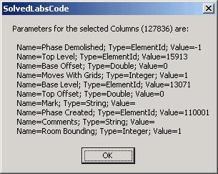
Loop all Element Parameters
Parameters
' List all UI-visible Params
Dim sMsg As String = "Parameters for the selected " & elem.Category.Name & " (" & elem.Id.Value.ToString & ") are:" & vbCrLf
Dim param As Parameter
For Each param In elem.Parameters
Dim paramName As String = param.Definition.Name
Dim paramType As String = param.StorageType.ToString
Dim paramValue As String = LabUtils.GetParamAsString(param)
sMsg += " Name=" & paramName & "; Type=" & paramType & "; Value=" & paramValue
Next
MsgBox(sMsg)
Public Shared Function GetParamAsString(ByVal param As Parameter) As String
Dim str As String
Select Case param.StorageType
Case StorageType.Double
str = param.AsDouble.ToString
Case StorageType.Integer
str = param.AsInteger.ToString
Case StorageType.String
str = param.AsString
Case StorageType.ElementId
str = param.AsElementId.Value.ToString
End Select
Return str
End Function
Notes:
Loop over the entire Parameters collection of an element.

Slide 88
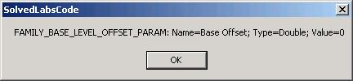
Access Built-in Parameter
Parameters
' If we know WHICH param we are looking for, then:
' A) a standard parameter, can be got via BuiltInParam signature of Parameter method:
Dim parInBuilt As Parameter
Try
parInBuilt = elem.Parameter(BuiltInParameter.FAMILY_BASE_LEVEL_OFFSET_PARAM)
If Not parInBuilt Is Nothing Then
Dim parInBuiltName As String = parInBuilt.Definition.Name
Dim parInBuiltType As String = LabUtils.GetParamStorageType(parInBuilt).ToString
Dim parInBuiltValue As String = LabUtils.GetParamAsString(parInBuilt)
MsgBox("FAMILY_BASE_LEVEL_OFFSET_PARAM: Name=" & parInBuiltName _
& "; Type=" & parInBuiltType & "; Value=" & parInBuiltValue)
Else
MsgBox("FAMILY_BASE_LEVEL_OFFSET_PARAM is NOT available for this element")
End If
Catch
MsgBox("FAMILY_BASE_LEVEL_OFFSET_PARAM is NOT available for this element")
End Try
Notes:
Access a specific built-in element parameter.

Slide 89
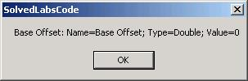
Access Named Parameter
Parameters
'Helper to get *specific* parameter by name
Shared Function GetElemParam(ByVal elem As Revit.Element, ByVal name As String) As Parameter
Dim parameters As Autodesk.Revit.ParameterSet = elem.Parameters
Dim parameter As Autodesk.Revit.Parameter
For Each parameter In parameters
If (parameter.Definition.Name = name) Then
Return parameter
End If
Next
Return Nothing
End Function
' C) use GetElemParam utilty to get it by hard coded-name
' (this works for either standard or shared!):
Const csParamToFind As String = "Base Offset"
Dim parByName As Parameter = LabUtils.GetElemParam(elem, csParamToFind)
If parByName Is Nothing Then
MsgBox(csParamToFind & " is NOT available for this element")
Else
Dim parByNameName As String = parByName.Definition.Name
Dim parByNameType As String = LabUtils.GetParamStorageType(parByName).ToString
Dim parByNameValue As String = LabUtils.GetParamAsString(parByName)
MsgBox(csParamToFind & ": Name=" & parByNameName & "; Type=" & parByNameType & "; Value=" & parByNameValue)
End If
Notes:
Access a specific named element parameter. This kind of access is language dependent!

Slide 90
Element Parameters Collection is Incomplete
Parameters
Most elements have more parameters than those listed in the Parameters collection
One way to find more is to attempt to retrieve a parameter for each one of the over 2000 built-in parameters enum values
This is implemented by the BuiltInParamsChecker and also by RvtMgdDbg 'Built-in Enums Snoop...'
For instance, every family instance has a Room property represented by the ELEM_ROOM_ID built-in parameter, which is not listed in the Parameters collection on a door element

Slide 91
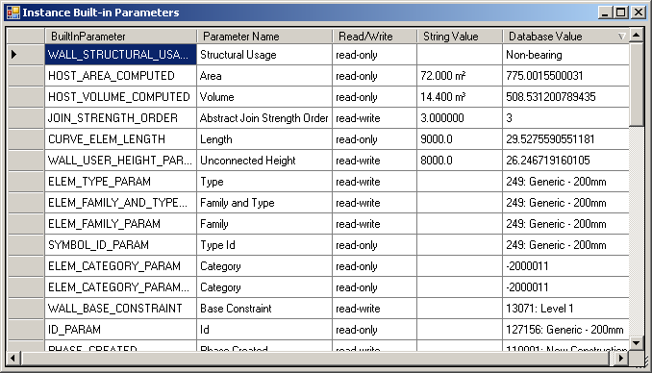
BuiltInParamsChecker
Parameters
Determine all valid built-in parameters for a selected element
Loop through all built-in parameter enums
Try to obtain a valid parameter for each
Sortable results using DataGridView
Notes:
The parameters returned in an element’s Parameters collection sometimes differs from the list of parameters that can be queried individually from the element by using the individual built-in parameter access. Therefore, it is useful to be able to determine all valid built-in parameters for a selected element. This is implemented by the BuiltInParamsChecker utility included in the labs, also described in a devnote or technical solution TS87913 on the ADN site. For a selected element, it loops through all the built-in parameter enums and tries to obtain a valid parameter for each, printing out the list of valid results. Currently, the built-in parameters and their meanings are not documented, so you have to find them out by trial and error.

Slide 92
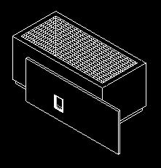
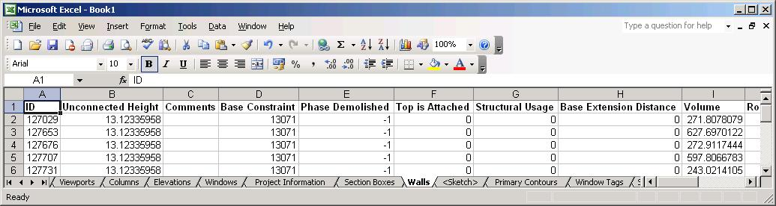
Exporting Parameters
Parameters
Exporting Revit BIM data to an external application
How do we use COM Interop in .NET to access e.g. MS Excel from Revit?
Lab 4-2
Out-of-process client
Create a map containing all non-symbol elements which have a valid category
Sort all elements into separate sets for each category
Start up Excel and create a new workbook
For each category, add a worksheet
Iterate over all elements in the set for that category
Determine all parameter names used for one category
Add a title row listing the parameter names
Add one row for each element listing all its parameters
Notes:
Iterate over all document elements and sort them into separate collections for each category. At the end, we will have separate collections for doors, walls, windows, etc. Launch Excel through .NET COM interop, add a new workbook, and add a new sheet for each of the categories we found. For each category, i.e. worksheet, use the Revit parameter definition names to create the worksheet headers. Loop through all the elements in the current category and determine all parameters for each. 'For each parameter in Parameters' is one way to iterate, the ParameterSetIterator is another. Create the table headers in the current sheet. Iterate over all the elements in the current category. For each element, iterate over all the parameters we have determined for this category, get their values from the Revit element and write them to the worksheet cells.

Slide 93
Shared Parameters
Parameters
Use shared parameters to add per-element data to Revit elements
Export and import these parameters to and from third party applications
Lab 4-3 (3 commands)
Similar to the SDK Sample FireRating
Create shared parameter for all doors
Export shared parameter data to Excel
Import shared parameter data from Excel
Notes:
Create a wall with a door in it, at least, before running this command. Also, you may need to set the full path defned in GetSharedParamsFile(). It is currently "C:\tmp\Labs-4-3-1.txt". After running the second command, show the excel spreadsheet, update the value of "API FireRating", and save the file, noting its name and location. In the third step, reopen the recently saved file. Note that the parameter of the door is updated from the Excel file.

Slide 94
Create Shared Parameter
Parameters
Get shared parameters definition file
Class Parameters.DefinitionFile
Application.Options.SharedParametersFilename
Application.OpenSharedParameterFile
Get shared parameters group
Class Autodesk.Revit.Parameters.DefinitionGroup
DefinitionFile.Groups
DefinitionFile.Groups.Create
Get shared parameters definition
Class Parameters.Definition
DefinitionGroup.Definitions
DefinitionGroup.Definitions.Create
Create category set for binding to 'Doors‘
CategorySet = revitApp.Create.NewCategorySet()
catSet.Insert( doc.Settings.Categories.Item( BuiltInCategory.OST_Doors ) )
Bind the parameter
Dim binding As Parameters.Binding = revitApp.Create.NewInstanceBinding( catSet )
doc.ParameterBindings.Insert( fireRatingParamDef, binding )

Slide 95
Export Shared Parameter
Parameters
Start up Excel
Get all standard family instances for the given category ‘Doors’
Determine the shared parameter GUID for accessing values
Dim guid As Guid = guid.Empty
Dim file As Parameters.DefinitionFile = revitApp.OpenSharedParameterFile
Dim group As Parameters.DefinitionGroup = file.Groups.Item(defGroup)
Dim definition As Parameters.Definition = group.Definitions.Item(defName)
Dim externalDefinition As Parameters.ExternalDefinition = definition
guid = externalDefinition.GUID
Loop all doors and export each to an Excel row
id, level, tag, fire rating
worksheet.Cells(row, 1).Value = door.Id.Value
worksheet.Cells(row, 2).Value = door.Level.Name
Dim tagParameter As Parameter = door.Parameter( BuiltInParameter.ALL_MODEL_MARK )
worksheet.Cells(row, 3).Value = tagParameter.AsString
Dim parameter As Parameter = door.Parameter( paramGuid )
worksheet.Cells(row, 4).Value = parameter.AsDouble
row = row + 1

Slide 96
Import Shared Parameter
Parameters
Select file, start up Excel, open file
Import data
Dim id As Integer
Dim fireRatingValue As Double
Dim row As Integer = 2
Do
' Extract relevant XLS values
id = worksheet.Cells(row, 1).Value
If id <= 0 Then Exit Do
fireRatingValue = worksheet.Cells(row, 4).Value
' Get document's door element via Id
Dim elementId As Autodesk.Revit.ElementId
elementId.Value = id
Dim door As Autodesk.Revit.Element = revitApp.ActiveDocument.Element( elementId )
' Set the param
If Not (door Is Nothing) Then
Dim parameter As Parameter = LabUtils.GetElemParam( door, sharedParamName )
parameter.Set( fireRatingValue )
End If
row = row + 1
Loop
Notes:
We retrieve the door id and the updated fire rating value from the Excel file, get the door element from Revit, get its shared parameter and update its value.

Slide 97
Shared Parameter for Entire Model
Parameters
How do we store per-document (per-model) data using shared parameters?
Bind hidden shared parameters to the singleton element of 'Project Information' category
The shared parameter definition uses ExternalDefinition, which has an attribute 'Visible'

Slide 98
Geometry
Notes:
Revit provides full access to the element geometry. The geometrical objects used are transient. They are generated on the fly by the API or an application and used to query or define element properties. They live in a separate namespace Autodesk.Revit.Geometry.

Slide 99



Access 3D Geometry
Geometry
Revit SDK sample viewers
RevitViewer
A simple geometry viewer helper class
Used by the other viewer samples
ElementViewer
Display wireframe model of one or more selected elements
RoomViewer
Wireframe viewer of the selected room
AnalyticalViewer
Display analytical model of one or more selected elements
ObjectViewer
Display analytical or physical model and set parameter of selected elements
FamilyExplorer
Profiles

Slide 100
Obtain 3D Element Geometry
Geometry
Private mOptions As Autodesk.Revit.Geometry.Options
mOptions = app.Create.NewGeometryOptions
mOptions.DetailLevel = Geometry.Options.DetailLevels.Fine
For Each elem In selSet
Dim geom As Autodesk.Revit.Geometry.Element = elem.Geometry(mOptions)
DrawElement(geom)
Next
If selSet.Size > 0 Then
mViewer.ShowModal()
End If
Specify level of detail of element geometry
Coarse, Medium, or Fine
All that remains is to display the geometry
Notes:
Each element may have geometery associated with it. The element geometry is returned by its Geometry method, which takes an argument specifying the required detail level: Coarse, Medium, or Fine. Here is code from the ElementViewer sample queriying each element in the selection set for its geometry and passing it into a drawing routine.

Slide 101
Display Element Geometry
Geometry
Private Sub DrawElement(ByVal elementGeom As Geometry.Element)
Dim geomObject As Autodesk.Revit.Geometry.GeometryObject
For Each geomObject In elementGeom.Objects
If (TypeOf geomObject Is Autodesk.Revit.Geometry.Curve) Then
DrawCurve(geomObject)
ElseIf (TypeOf geomObject Is Autodesk.Revit.Geometry.Instance) Then
DrawInstance(geomObject)
ElseIf (TypeOf geomObject Is Autodesk.Revit.Geometry.Mesh) Then
DrawMesh(geomObject)
ElseIf (TypeOf geomObject Is Autodesk.Revit.Geometry.Solid) Then
DrawSolid(geomObject)
End If
Next
End Sub
Private Sub DrawCurve(ByVal geomCurve As Geometry.Curve)
DrawPoints(geomCurve.Tessellate)
End Sub
Notes:
Iterate over the element geometry, which in turn is a Geometry.Element instance containing curve, instance, mesh and solid objects which in turn are broken down into line segments for the viewer. For more details, please refer to the SDK sample source code.

Slide 102


Access to 2D Geometry
Geometry
Display room id, name and number
Iterate over room boundary lines
See also SDK sample RoomViewer
Lab 5-3
Notes:
Rooms also have geometry associated with them. In this case, the geometry is the 2D room boundary lines. This is demonstrated by Lab 5-3. In order to explore lab 5-3, create four walls and a room. The room id, name and number as well as the geometrical coordinates of its boundary lines are displayed. RoomViewer displays the room boundary graphically in its own embedded viewer.

Slide 103
Iterate Room Boundary
Geometry
Dim boundaries As BoundarySegmentArrayArray = room.Boundary
Dim boundary As BoundarySegmentArray
Dim iB As Integer = 0
For Each boundary In boundaries
iB += 1
sMsg += vbCrLf & " Boundary " & iB & ":"
Dim iSeg As Integer = 0
Dim segment As BoundarySegment
For Each segment In boundary
iSeg += 1
Dim crv As Geometry.Curve = segment.Curve
If TypeOf crv Is Geometry.Line Then ' LINE
Dim line As Line = crv
Dim ptS As XYZ = line.EndPoint(0)
Dim ptE As XYZ = line.EndPoint(1)
sMsg += vbCrLf & " Segment " & iSeg & " is a LINE:" & _
ptS.X & ", " & ptS.Y & ", " & ptS.Z & " ; " & _
ptE.X & ", " & ptE.Y & ", " & ptE.Z
ElseIf TypeOf crv Is Geometry.Arc Then ' ARC
Dim arc As Arc = crv
Dim ptS As XYZ = arc.EndPoint(0)
Dim ptE As XYZ = arc.EndPoint(1)
Dim r As Double = arc.Radius
sMsg += vbCrLf & " Segment " & iSeg & " is an ARC:" & _
ptS.X & ", " & ptS.Y & ", " & ptS.Z & " ; " & _
ptE.X & ", " & ptE.Y & ", " & ptE.Z & " ; R=" & r
End If
Next
Next
Notes:
The room boundary is accessible through the property Boundary, which returns a BoundarySegmentArrayArray, i.e. a collection of arrays of boundary segments. Each array of boundary segments is one boundary, and each boundary segment has a curve, which can be a line or an arc, for instance.

Slide 104

Time Out
We are taking a 5 minute break
Introduction
Getting Started
Basics
Database Elements
Families and Types
Parameters
Geometry
Break
API Updates
Ribbon, Events, VSTA
API News
New samples
Family API
Form creation
MEP API

Slide 105
Revit 2010 API News
News
Platform changes
.NET Framework 3.5
Visual Studio 2008
64-bit
Function signature changes
Updated and Replacement APIs
Ribbon GUI
Events
VSTA
New APIs
Model Inspection Utilities
Family API
Form Creation
MEP API
Notes:
We have a huge amount of new material to cover in the API update, and will not be able to cover everything completely in this initial introduction. We are looking forward to presenting more detailed and in depth webcasts on selected topics in coming months and would very much appreciate your feedback on topics to cover.
The ribbon and event APIs are actually new, in a sense. On the other hand, they replace other older APIs that existed in 2009 and previous versions and are now deprecated or obsolete. Applications making use of the old APIs are recommended to be ported to the new ones. The model inspection utilities are just a minor point. The biggest new topic is the family API, with a big subtopic on form creation and also the MEP API.

Slide 106
Ribbon API
User Interface Customisation

Slide 107
Ribbon API
Ribbon API
The Ribbon API is the only GUI customization API
Menus and toolbars need to be migrated to ribbon
Easy to use
No WPF knowledge needed
Guidelines provided
Ribbon design guidelines.pdf
Autodesk Icon Guidelines.pdf
To be extended in future releases
Notes:
As we have seen earlier, Revit 2010 has a completely new look with a ribbon based UI. Unlike AutoCAD based products, this change is not optional. There is no way to turn this off and switch back to the old UI. If you used toolbars in Revit 2009 and earlier, you will need to migrate your application to use the ribbon. The API is available to add your custom ribbon panels. In addition to the programming aspect, we also provide documentation with guidelines for designing your custom ribbon and icons. This is to ensure that your application is nicely integrated with Revit UI. The document also explains all the terminology used to describe Ribbon UI. You can find the documentation in the SDK folder:
Ribbon design guidelines.pdf
Autodesk Icon Guidelines.pdf
For those who are familiar with the AutoCAD API, you should note that the API for AutoCAD and Revit is different, at least in the 2010 release. Focus on the UI side of the Revit API is yet to come. We expect to revisit the ribbon API for more flexibility in future releases. The good news is that it is quite straight-forward to use. There is no need to learn WPF, for example.

Slide 108
Ribbon Controls
Ribbon API
External commands and applications are located on the Add-Ins tab
Custom ribbon tab cannot be created
External commands under External Tools
External applications on custom ribbon panel
Push button
Pull-down button
Single or stacked layout with two or three rows
Notes:
At the moment, you cannot create a separate ribbon tab. All External Application and External Command related user interface items are placed on the Add-Ins Tab. You see this tab when you add an external application or command section to the Revit.ini file. External commands are listed under the External Tools button. External applications can create their own ribbon panels and populate them with push buttons and pull-down buttons in either a normal, single or stacked fashion with the option of two or three layers.

Slide 109
Ribbon Classes
Ribbon API
RibbonPanel
A ribbon panel in the Add-Ins tab
A panel contains a number of ribbon items or buttons
RibbonItem
A button, push or pull-down
PushButton, PushButtonData
Manage push button information
PulldownButton, PulldownButtonData
Manage pull-down button information

Slide 110

Ribbon Sample
Ribbon API
Two add-in application ribbon panels
Push button 'Create Wall'
Three-layered stacked button
Pull-down button 'Move Walls'
Tooltip
Separator
Notes:
The figure shows an example of ribbon panels added by API. In the figure, it shows two ribbon panels called “Ribbon Sample” and “Add-in Panel Info”. “Ribbon Sample” panel on the left has one push button called “Create Wall”, and one three-layered stacked button next to it (one showing “Delete Last Wall” at top). Notice that the third stacked button, “Move Walls”, is a pull-down button. You can also add a tooltip and a separator between buttons.

Slide 111
Ribbon Sample
Ribbon API
[Revit SDK]\Samples\Ribbon
// create a Ribbon panel which contains three stackable buttons
// and one single push button.
string firstPanelName = "Ribbon Sample";
RibbonPanel ribbonSamplePanel = application.CreateRibbonPanel( firstPanelName );
// use AddPushButton method to add one single large PushButton
PushButton createWallBut = ribbonSamplePanel.AddPushButton(
"createWall", "Create Wall", AddInPath,
"Revit.SDK.Samples.Ribbon.CS.CreateWall" );
createWallBut.ToolTip = "Create a wall on level 1.";
createWallBut.LargeImage = new BitmapImage( new Uri( Path.Combine(
ButtonIconsFolder, "CreateWallLarge.png" ), UriKind.Absolute ) );
createWallBut.Image = new BitmapImage( new Uri( Path.Combine(
ButtonIconsFolder, "CreateWall.png" ), UriKind.Absolute ) );
In C#
Notes:
Here is a code snippet of from the Ribbon SDK sample application. It defines the custom ribbon panel shown on the previous slide.

Slide 112
Events

Slide 113
Revit 2010 New Events
Events
Compliant to the .NET event standard
Many of the new pre-events are cancellable
All existing events are deprecated
Currently not supported in VSTA
Notes:
The new events are compliant to the .NET event standard. The way to subscribe and unsubscribe to events is the same when we add events handlers in .NET programming.
All existing events are deprecated. This means that you are recommended but not forced to re-write the code.
New events have been added. We will talk more about the new events in another slide.
Events now occur before and after various triggering actions (known as "pre" and "post" events). Many of the new pre-events are cancellable, offering the API application the ability to prevent the event from taking place.
Events are not supported in the VSTA macro environment.

Slide 114
Revit 2010 New Events
Events
File export
Application.FileExported, Application.FileExporting
File import
Application.FileImported, Application.FileImporting
View printing
Application.ViewPrinting
Document printing
Application.DocumentPrinting, Application.DocumentPrinted
View activate
Application.ViewActivating, Application.ViewActivated
Document synchronizing central
DocumentSynchronizingWithCentral, DocumentSynchronizedWithCentral

Slide 115
Event Samples in SDK
Events
Old event sample ApplicationEvents was removed
Five new samples have been added
AutoStamp
Automatically stamp document when a view is printed: subscribe to ViewPrint events, create and delete a TextNote element in the event handler and cancel the event if creation fails
AutoUpdate
Subscribe to the DocumentOpened event and modify the model in the event handler
CancelSave
Cancel the document save process through the DocumentSaving and DocumentSavingAs event arguments
Event Monitor
Subscribe to all application level events and display them in an event tracking window
PrintLog
Subscribe to print related events, access properties in the event handler arguments and dump print related information to a log file
Notes:
As the event handling API changed, the old event sample ApplicationEvents was removed from the SDK. Five new event samples have been added to demonstrate the usage and functionality of new Event API. They are located in the …\Samples\Event subfolder.

Slide 116
Event Example: Prevent Saving Document
Events
Subscribe to DocumentSaving event
Choice to save or unsave document
Unsubscribe to event
Lab 6

Slide 117
Using Events
Events
public IExternalApplication.Result OnStartup( ControlledApplication a )
{
a.DocumentSaving += new EventHandler<DocumentSavingEventArgs>(
CheckProjectStatusUpdate );
return IExternalApplication.Result.Succeeded;
}
public IExternalApplication.Result OnShutdown( ControlledApplication a )
{
a.DocumentSaving -= new EventHandler<DocumentSavingEventArgs>(
CheckProjectStatusUpdate );
return IExternalApplication.Result.Succeeded;
}
private void CheckProjectStatusUpdate( Object sender,
DocumentSavingEventArgs args )
{
if( args.Cancellable ) {
// Show dialog to decide whether to save the document.
}
}

Slide 118
VSTA
Visual Studio Tools for Applications

Slide 119
VSTA
VSTA
Visual Studio Tools for Applications
Microsoft technology
Provides application extensibility
Built on Visual Studio and the .NET Framework
Integrated into a main application
Provides a standardized toolset and a managed extensibility environment
VSTA projects open in full Visual Studio
VSTA continues to inherit innovations in Visual Studio and .NET
Successor of VBA, Visual Basic for Applications, in Autodesk applications

Slide 120
Revit VSTA
VSTA
Two levels of macros
Document level – embedded in .rvt file and available to anybody who opens it
Application level – saved under: <Revit install>\Program\VstaMacros\AppHookup
Almost same syntax as external command with a few exceptions
Installation
Installed automatically by default
For each Revit flavor
No need for full MSVS
Documentation
Revit Architecture 2010 User's Guide > Creating Macros with Revit VSTA
Samples
Revit SDK > VSTA Samples folder
21 document add-ins in three .rvt files
2 application add-ins
Supports both C# and VB.NET

Slide 121

Revit VSTA Commands
VSTA

Slide 122


Revit VSTA Macro Manager
VSTA
Manage tab > Macro manager

Slide 123

Revit VSTA IDE
VSTA

Slide 124

VSTA Features in 2010
VSTA
Using VSTA 2.0
Macro Security setting
Options dialog tab to define behavior on startup or document open
Application macro setting
Enable or disable application macros
Document macro setting
Enable or disable document macros
Ask before enabling
Events are not supported in the macro environment
Create multiple modules, which launches multiple instances of Visual Studio IDE

Slide 125

Revit VSTA Documentation
VSTA
Revit Architecture 2010 Help item in help menu
Creating Macros with Revit VSTA
Getting Started with Macros
Using Macro Manager and the Revit VSTA IDE
Revit SDK, API Reference Documentation, VSTA Samples
Using the Revit VSTA Samples from SDK
Integrating Macros into Revit VSTA
Revit API Differences
Migrating SDK Samples to Revit VSTA
Revit Macros FAQ
Related Information about Revit Macros

Slide 126
Revit VSTA Samples
VSTA
Document level macros
Revit_VSTA_Samples.rvt: 15 samples, e.g., capitalizing text, quick print, creating beams and columns
Revit_VSTA_MEP_Samples.rvt: avoid obstruction
Revit_VSTA_Family_Sample.rvt: e.g., auto join, generic model creation, type regeneration
Application macros
GetTimeElapsed_CSharp/VBNet
Rooms
Detailed descriptions
VSTA Samples Readme.doc

Slide 127
New APIs
New Revit 2010 API Samples and Features
Model Inspection, Family, Form Creation and MEP API

Slide 128
23 New Revit SDK Samples
New Samples
Generic
RaytraceBounce
Ribbon
Revit MEP
AutoRoute
AvoidObstruction
TraverseSystem
Events
AutoStamp
AutoUpdate
CancelSave
EventsMonitor
PrintLog
FamilyCreation
AutoJoin
AutoParameter
CreateAirHandler (rme)
CreateTruss (rst)
DWGFamilyCreation
GenericModelCreation
TypeRegeneration
ValidateParameters
WindowWizard
Massing
DistanceToPanels
MeasurePanelArea
NewForm (5 commands)
PanelEdgeLengthAngle
Notes:
The 23 new samples reflect the main focus of the API development for this release: family API and conceptual design, ribbon, events, MEP. Events, FamilyCreation and Massing are separate subdirectories, the other samples are located in the main SDK Samples folder. To compile them all, you can use the main solution file. To load them into Revit, you can use the RvtSamples external application. We already discussed the ribbon and events samples. We will look at the family, form creation, and MEP ones in the later sections of the presentation. One sample that does not fall into any of these categories is RaytraceBounce, which demonstrates a new general-purpose model inspection method.

Slide 129


RaytraceBounce
New Samples
Execute FindReferencesByDirection()
New general-purpose model inspection method
Implements ray trace bounce for one single ray
Find intersection between ray and face
Calculate reflection angle and launch next ray recursively
Create connecting lines as model lines and log to file

Slide 130

Model Inspection Utilities
New APIs
Volumes, rooms and spaces
Room.IsPointInRoom() determines if a 3D point is in the volume of a room
Space.IsPointInSpace() determines if a 3D point is in the volume of a space
GetRoomAtPoint() and GetSpaceAtPoint() returns room or space containing given 3D point
FamilyInstance.Space determines space containing air terminal or other family instance in Revit MEP
Ray intersection
FindReferencesByDirection returns an array of elements, faces, and references found when moving through the model from a specified point in a specified direction
RayTraceBounce SDK sample
Other miscellaneous API enhancements
Element Hiding
Add Shared Parameters to materials and other formerly API-hidden categories
Find built-in parameters associated with elements
Curtain grid line segments using new ExistingSegmentCurves property
Mullion provides access to location via its LocationCurve property
Abstract method AddSegments in hosted sweep base class for gutter, fascia and slab edge use
Identify the Revit vertical product as enum
Identify the Revit localized language
Improved external application diagnostics
Notes:
To allow hiding and un-hiding of elements via the API, the methods View.Hide(ElementSet) and View.Unhide(ElementSet) have been added. The properties Element.IsHidden(View) and Element.CanBeHidden(View) return a boolean value that indicates if an element is current hidden and if it can be hidden.
Internal categories that are not directly exposed through the Revit UI can be accessed via the API. This makes it possible to add shared parameters to Materials using Revit API.
The new property Autodesk.Revit.Parameters.InternalDefinition.BuiltInParameter provides access to the enumerated type for the parameter, if it is a built-in parameter. The property makes it easier to set a parameter value based on the name of the parameter shown in the Revit UI.
Autodesk.Revit.Elements.CurtainGridLine new property ExistingSegmentCurves allows access to the existing segments in the grid line (excluding those which have been removed).
Autodesk.Revit.Elements.Mullion now provides access to its locaction via the LocationCurve property.
In the Autodesk.Revit.Elements.HostedSweep class the new abstract method AddSegment() allows applications to write generic code that operates upon all hosted sweep types (gutter, fascia, or slab edge).
The new Autodesk.Revit.Application.Language property identifies the language used in the current session of Revit.
The new Autodesk.Revit.Application.Product property identifies the Revit vertical application (Building, Structure, MEP) via an enumerated type.
Revit's macro functionality is now based on VSTA 2.0. More information about VSTA and version 2.0 are available on Microsoft's MSDN Developer Center at http://msdn.microsoft.com/en-us/vsx2008/products/bb933739.aspx
The last one – “Improved External Application Diagnostics” – if you are Revit programmer, I’m sure you have experienced once or twice that there is nothing happens when you choose external tools. You might have misspelled the name of your dll. With this enhancement, when something is wrong with an external program, this will show the reason more in detail; For example, when revit cannot find the dll, or function name. etc.

Slide 131
Family API
Families, conceptual design and form creation

Slide 132
Family API
Family API
History
Two large disjunct developer communities
Revit applications using the API
Revit content with no API access
Families is an enormous strength
Family API was the top wish list item
Huge potential for synergy uniting the two separate camps
Family API enables
Use the Revit API within the family editor context
Create and modify family content
Automatic library generation from database or other library specification
Extract family definitions from existing projects
Define references and constraints to drive model geometry parametrically, formulas to drive parameter values, add annotation and dimensioning
Control detailed visibility of family types end their elements
Control loading behaviour of a family
Notes:
Exposure of Family API is probably the most important enhancement to the Revit API in 2010. The concept of component family is a unique feature and strength of Revit. This is the most wanted feature in the Revit API community and we expect the effect and growth in possibilities with the availability of family API will be dramatic. An obvious opportunity provided by the new family API is the automatic generation of content from databases or other library sources. It is also possible to extract a family definition out of a project and store it back into an external family file. Revit Platform API Changes and Additions.doc found under Revit SDK folder provides overview of Revit Family API. Samples are located under <Revit SDK>\samples\FamilyCreation folder.

Slide 133

Revit Families – What is it?
Family API
Graphic representations of building objects and symbols
Geometry in 3D or 2D
Data
Generically - 3 Types
System Families – stored in the project template
Walls, Roofs, Floors, Ceilings, Rebar…
Standard Families – freestanding “.rfa” files *API in 2010
Windows, Doors, Furniture, Beams, Ductwork…
In-Place Families – “one of kind objects”
Notes:
Before discussing the new Revit family API, it is important to understand the basics of Revit families and their definition.
Families in Revit are graphical representations of building objects and symbols. It could be 2D or 3D geometric objects. It could be a data objects.
There are three kinds of families:
(1) System family – which is stored in the project template. Objects like, walls, roofs, floors, ceilings are in this category.
(2) Standard family – uses .rfa file. Windows, doors, furniture, beams are in this category.
(3) In-place families – this third category is the one stored in project and creates one of a kind of objects.
The API in 2010 supports the second category, standard families.

Slide 134



Revit Families – Where to begin
Family API
Which is better?
Start from a family template
Modify an existing family
Which Family template to start with?
2D or 3D, model or detail component
Hosted or non hosted: Wall, Ceiling,…
Category
Placement type: free or 2 point
Specialty: Lighting, RPC, …
Notes:
Regardless of whether you are using the UI or API, the first thing you will need to decide is which template or family file you want to begin with.
- You can create a family starting from a family template.
- You can also take an existing family and start from there.
There are plenty of templates to choose from. You will need to decide which template to start with. Typically, you will need to think about:
- Is your family 2D or 3D? Model or detail?
- Is it hosted or hosted, to a wall, ceiling?
- What about the category?
- How do you want to place it? Anywhere on a project? By two points?
- Do you need a specialty one, such as lighting, or RPC?

Slide 135
Revit Family Flavours
Family API
Revit Architecture
Basic building components with simplistic interactions in the model
Free placement objects - casework, furniture, etc.
“2 point” placement objects - detail components, hosted objects
Hosted objects – windows, doors, columns (“level to level”), ceiling or “wall based” lighting fixtures
Revit Structure
Additional components with complex interactions with other objects
Framing - beams (“beams to beam”, “beam to column”), columns
Trusses - layout for girder trusses; Boundary Conditions
Span Direction Symbols; Reinforcement Symbols - area reinforcement expands to find edges, path reinforcement
Revit MEP
Connectors allowing objects to resize based on what they are connected to
Notes:
Just like products, Family also has three flavours. Most of the functionalities are same as Revit Architecture.
Revit Architecture
- Family in Revit Architecture supports basic building components with simplistic interactions in the model.
(MH: you can skip to structure here. These are similar to what we said in previous slides.)
- Free placement objects - casework, furniture, etc.
- “2 point” placement objects - detail components, hosted objects
- Hosted objects – windows, doors, columns (“level to level”), ceiling or “wall based” lighting fixtures.)
Revit Structure
- Has Additional components with complex interactions with other objects. In particular ones that support analytical models:
- Framing - beams (“beams to beam”, “beam to column”), columns
- Trusses - layout for girder trusses; Boundary Conditions
- Span Direction Symbols; Reinforcement Symbols - area reinforcement expands to find edges, path reinforcement
In Revit MEP
- Connectors allowing objects to resize based on what they are connected to.

Slide 136
Revit Family Editor
Family API
Revit offers 6 basic family editors
3D model, annotation, detail, rebar, truss and new conceptual mass.
Each family editor provides a specific set and is tied to the chosen family template
Geometry – extrusions, blends, sweeps, revolves
Lines – model, symbolic, detail
Basic tools – copy, mirror, paint, join/unjoin, cut geometry/don’t cut
References – reference planes, reference lines
Annotation tools – labels
Advanced tools – formulas, nesting, arrays, type catalogs
MEP tools – add connectors
Notes:
Of the six basic family editors, the conceptual mass creation one is new to 2010. Depending on the editor, you will see a different set of available tools or tools to create building blocks. For instance, you will see tools to create forms in the model editor, but not in the annotation one. If you are using the truss editor, you will see top/bottom chord, which will be shown in the model editor.

Slide 137

Revit Families Best Practice
Family API
The “Process” for building families
Most important aspect of family creation: one needs to learn
Process order:
Plan (Insertion Point, Parametric Origin)
Layout Reference Planes (The Bones)
Add Parameters
Add multiple host thickness types
Add 2 or more types
Flex Types and Host (Testing Procedure)
Add a Single Level of Geometry
Repeat Steps 6 and 7 until you are satisfied with the results
Test in Project Environment (create testing project)
Steven Campbell, Revit content management project manager
Notes:
Family is a powerful feature in Revit, creating a Family could be fun, but it could be complex. When it becomes complex, it requires a good planning. Here are some suggestions when building families by the Autodesk Revit content manager Steve Campbell.
The same applies to API; a key to understand Family API is to understand UI.

Slide 138






Revit Families – What is possible
Family API
Formulas – can be used to control behavior, visibility, arrays
Arrays and nesting – repeatable, resizable elements across an array
Advanced nesting – subcomponents can be swapped
Reference lines – angular movement
Notes:
You can create a quite complex object using family. For example,
- Formulas can be used to control behavior, visibility, arrays. For example, define arrays of bolts depending on the size of a plate.
- Arraying nested components allows the user to create families with repeatable elements across an array that can resize based on user input or rules. For example, a bookshelf with arrayed shelves. Mullion patterns based on rules. Open web joists that adjust based on length and height.
- Advanced nesting - Using nested families with the Family Type parameter can provide flexible components with swappable sub-components such as nested door panels, frames, hardware, playground equipment, shown on the right, swappable panels and components.
- Reference lines allow geometry to move about in an angular fashion. They contain two endpoints and two “built in” work planes that can be parametrically controlled. Simple examples: Door swing (lower middle) that can change the opening angle. Light fixture head that moves and points; Complex example: Excavator arm (lower left) that can bend and rotate about 3 or more pivot points.

Slide 139
Document and family manager classes
Family API
Dedicated methods and properties for managing families
Document.EditFamily – edit a family loaded in a project document
FamilyCreate – returns a FamilyItemCreate object to create new instances of elements within a family document, analogous to the Create object in a project
FamilyManager – returns a FamilyManager object to provide access to family types and parameters
IsFamilyDocument – identifies whether the current document is a family document
OwnerFamily – returns the owning family of this family document
Family manager class functionality
Add, remove and rename types
Add and remove parameters
Set values and formulas

Slide 140

Creating Family Content
Family API
Family item factory utility object
Create new instances of elements within the family document
Dedicated creation methods instead of the .NET new operator
Elements types include
Alignment
Connector (MEP only)
Dimensioning
Annotation
Curves
Levels
Solids forms
Notes:
FamilyCreate returns a FamilyItemFactory instance. The family item factory object is a utility object used to create new instances of elements within the family document. Just like other Revit elements, these are instantiated using dedicated methods instead of the .NET new operator. This ensures that the elements created are added correctly to the family document. A wide range of elements types can be created, including alignments, dimensioning, annotation, curves, levels, as well as solids forms, such as ones we have seen in the conceptual design section above. It is an important subset of the family API.

Slide 141
Visibility Settings and Loading Control
Family API
Visibility
Every element in the family has own visibility settings
Define which levels of detail it has
Which types of views it appears in
FamilyElementVisibility class
Loading
LoadFamily has various overloads
Takes Document or filename string argument
Optional argument interface IFamilyLoadOptions
Call-backs for handling family load situations
OnFamilyFound
OnSharedFamilyFound
Notes:
A critical topic when building family content is the visibility settings. It is now accessible for each element in a family through the new FamilyElementVisibility class.
Each element in a family has its own visibility settings which define which levels of detail it has and which types of views it appears in. These options are critical to building good content. For example, intricate details of a family should only be visible in the fine detail views. 3D solid content could optionally be suppressed in plan views, where light weight 2D line work could be displayed instead. Such an approach can make a substantial performance difference, especially in large building models.
The Document.LoadFamily method has been enhanced and new overloads are added, which can help to handle situations such as when a family already exists in the project. The following overloads are now provided:
LoadFamily(Document) - loads the contents of this family document into another document.
LoadFamily(String) - loads an entire family and all its types into the document.
LoadFamily(String, Family ) - loads an entire family and all its types into the document and provides a reference to the loaded family.
LoadFamily(Document, IFamilyLoadOptions) - loads the contents of this family document into another document.
IFamilyLoadOptions is an interface class which defines two call-backs for handling family load situations: OnFamilyFound, OnSharedFamilyFound. These are called when family or shared family was already present in the target document.

Slide 142

Family API Samples
Family API
FamilyCreation folder in the SDK Samples directory
AutoJoin
Automatically join geometry of multiple generic forms for use in family modeling and massing
Uses the method Document::CombineElements to join geometry between overlapping generic forms
Provide a utility method check geometry object overlap, based on Face::Intersect(Curve) method
AutoParameter
Batch mode automatic addition of shared or non-shared parameters to one or more family documents
Process active family documentor all families in a folder
Uses FamilyManager class AddParameter methods
Reads input data from parameter text files in Revit shared parameter format
CreateAirHandler – RME
Create an air handler with pipe and duct connectors
Check the template family category to verify valid starting point
Use FamilyItemFactory class NewExtrusion, NewPipeConnector, NewDuctConnector methods
Set proper connector parameters and use Document::CombineElements to join the extrusions
CreateTruss – RST
Create a mono truss in a truss family document
Create truss curves using NewModelCurve, set truss type through ModelCurve TrussCurveType property
Add constraints to the truss curves with NewAlignment

Slide 143





More Family API Samples
Family API
DWGFamilyCreation
Import DWG file into family document add type parameters to the imported instance
DWGFileName with the DWG file name and ImportTime when it was imported
GenericModelCreation
Create a generic model using extrusion, blend, revolution, sweep and swept blend elements
Checks that open document is a family one or creates a new family document
Exercises CreateSketchPlane, NewLineBound, and FamilyItemFactory methods to create profiles and shapes
TypeRegeneration
Use FamilyManager Types property to determine all types defined, and CurrentType to iterate through them
Report whether all types regenerated successfully, log errors to file
ValidateParameters
Check whether every type has valid values for certain parameters and log result to file
External application subscribing to DocumentSaving and DocumentSavingAs events runs check automatically
External command to launch manually
WindowWizard
Create a window family via wizard user interface
Start in window family template, e.g. Metric Window.rtf
User defines input dimensions for window parameters and materials
Create extrusion, alignment, dimension, reference plane, and family type

Slide 144
Form Creation
Form Creation and Conceptual Design API

Slide 145


Form Creation API
Form Creation
New point and curve objects
New form-making tools
Resulting surfaces can be divided, patterned, and panelized
Notes:
The new conceptual Design API includes new point and curve objects, new form making tools and new surfaces that can be divided, patterned and panelized. You can use it to create schematic studies for curtain system designs and structural framing layouts, or even begin to apply real curtain panels to your form with these new and easy-to-use tools.

Slide 146
Form Creation Topics
Form Creation
Points
Curve by Points
Form
Loft
Swept Blend
Revolve
Extrusion
Divided Surface & Panel Components
Notes:
In the Form creation API, we will discuss 4 main topics of functionality – points, curves created using these points, forms (including the ones that are shown and listed in the slides), divided surfaces placed on faces of a form, and curve panel components placed on that surface.

Slide 147
ReferencePoint and CurveByPoints
Form Creation
Reference point can be created using -
XYZ
Transform
On Edge
On Edge/Edge Intersection
On Edge/Face Intersection
On Face
On Plane
ReferencePointArray – array of Reference Points for curve creation
NewCurveByPoints(ReferencePointArray points)
Notes:
Starting with the ReferencePoint class, which can be created using simple XYZ location, using Transform or one the 5 subclasses that allow a point to be placed in reference to some other geometry in the model allows us to, for example, place a reference point at the center of a edge and have that point update its location if the edge gets longer or shorter.
The reference point array is an array to store reference points, which is then used to create a curve.
The Curve by points method creates a curve using the reference point array.

Slide 148




Forms
Form Creation
Extrusion
NewExtrusionForm(bool isSolid, ReferenceArray profile, XYZ direction)
Revolve
NewRevolveForm(bool isSolid, ReferenceArray profile, Reference axis, double startAngle, double endAngle);
Notes:
Forms can be created using few methods in conceptual design API – extrusion method is one of the simple ones. This method creates an extrusion based on a planar, single curve loop profile and the extrusion height, which should be perpendicular to the profile plane.
The NewRevolveForm method creates a form by revolving a planar single curve loop profile around an axis. The axis should be in the same plane as the profile.

Slide 149




Forms
Form Creation
Swept Blend
NewSweptBlendForm(bool isSolid, ReferenceArray path, ReferenceArray profiles)
Loft
NewLoftForm(bool isSolid, ReferenceArray profiles)
Notes:
Swept blend form can be created using a set of two reference arrays: one to determine the path and another to determine the profiles. The start and the end profile should be perpendicular to the path and all the profiles and the paths should be planar and each comprise of single loop.
Loft is a new surface that can be created using a set of curves, all of which must be planar and each comprise of single curve. These are created, as with other profiles, by specifying if it is a solid or void and by specifying the profiles that should be used to create the form.

Slide 150




Forms
Form Creation
Cap Surface
NewFormByCap(bool isSolid, ReferenceArray profile)
Thicken Single Surface
NewFormByThickenSingleSurface(bool isSolid, Form singleSurfaceForm, XYZ thickenDir)
Notes:
Cap surface is a flat two-dimensional surface bounded by a planar, single loop profile.
ThickenSingleSurface method can be used to provide a depth to a cap surface, similar to extrusion. This creates a three dimensional form using a single two dimensional surface.

Slide 151
Modifying Forms
Form Creation
Delete, move, rotate and scale sub element
while (i < formLoft.ProfileCount)
{
int move = 3;
ReferenceArray ref_Array
= formLoft.get_CurveLoopReferencesOnProfile( i, iCurveLoopIndex );
Reference loft_ref = ref_Array.get_Item(0);
while (move < 14)
{
XYZ XYZmove = new XYZ(move, 0, 0);
formLoft.MoveSubElement(loft_ref, XYZmove);
doc.Save();
XYZmove = new XYZ(0, move, 0);
formLoft.MoveSubElement(loft_ref, XYZmove);
doc.Save();
XYZmove = new XYZ(0, 0, move);
formLoft.MoveSubElement(loft_ref, XYZmove);
doc.Save();
move = move + 2;
}
move = 0;
i = i + 1;
}
Notes:
Once a form is created, you can modify its specific sub-element, using four methods for delete, move, rotate and scale.
Each form element discussed above is defined using profiles. The form element exposes a profile count property called ProfileCount and a method to access each reference on the profile (i.e., CurveLoopReferencesOnProfile). You can modify the form at the desired profile by passing in the profile reference to one of the four form modification methods provided on the form element.

Slide 152


Divided Surface
Form Creation
Grid of parallelograms defined by AllGridRotation, USpacingRule, VSpacingRule
form = e as Autodesk.Revit.Elements.Form;
DividedSurfaceData dsData = form.GetDividedSurfaceData();
if (dsData != null)
{
foreach (Reference r in dsData.GetReferencesWithDividedSurfaces())
{
dsRefs.Append(r);
}
}
Notes:
Divided Surface functionality places a grid of parallelograms on the surface of a form. You can use the method FamilyItemFactory.NewDividedSurface() to create a divided surface. The appearance of the grid is controlled by the grid rotation angle and spacing rules and U and V direction. The figure shows an example of divided surface application and it values in the property dialog.
The divided surface information can be obtained from a given divided surface object, using the GetDividedSurfaceData method. This method returns the DividedSurfaceData class, which is a container of the divided surface data. From the DividedSurfaceData, you can use GetReferencesWithDividedSurfaces() method to access to references to the divided surface. The code snippet in the slide illustrates the access to DividedSurfaceData from the given form reference with divided surfaces.

Slide 153


Tile Pattern
Form Creation
TilePattern applied to the grid defined with ObjectType
Apply each TilePattern to a divided surface – TilePatternIteration sample
int count = 0;
TilePatterns tilepatterns = doc.Settings.TilePatterns;
foreach (Autodesk.Revit.Enums.TilePatternsBuiltIn TilePatternEnum in
Enum.GetValues(typeof(Autodesk.Revit.Enums.TilePatternsBuiltIn)))
{
pDividedSurface.ObjectType
= tilepatterns.GetTilePattern( TilePatternEnum );
doc.Save();
}
Notes:
Once we have the divided surface, next thing to be done is to apply set of patterns to it. This slide shows a images of patterns as shown in UI. These are a set of pre-defined hard-coded built-in tiling patterns which cannot be modified or new ones cannot be created in 2010. But we can place them on divided surface as framework for placing panels as we would see next in the following slide.
The code snippet below shows the iteration through the built-in enumeration of the tile patterns, which are available from the Document.Settings property. With each of the items of type TilePatternBuiltIn in the enumeration, we can get and set a specific patterns to the object type of the divided surface.

Slide 154

Curtain Panel
Form Creation
Special mass families built on a sample grid, similar to the host wall in a window/door family
When applied to a divided surface, the Revit creates Family Instances of the panel on the surface’s grid
New properties
Family.IsCurtainPanelFamily
Family.CurtainPanelHorizontalSpacing
Family.CurtainPanelVerticalSpacing
Family.CurtainPanelTilePattern
Notes:
Curtain Panel is a special mass family hosted by a grid, similar to window and door families hosted in a curtain wall. When curtain panels are applied to a divided surface, Revit creates a family instance of the panel on the surface’s grid. In the API, the divided surface has an ObjectType property that can be set to the panel to be used on the surface. Setting the ObjectType creates panel family instances for the grids. Each node in the grid has a marker indicating if it is a “seed node” or not. There is a seed node associated with every panel, but depending on the tile pattern and layout, there will be nodes that are not seed nodes.

Slide 155
Curtain Panel Code
Form Creation
GridNode gn = new GridNode();
int u = 0;
while (u < pDividedSurface.NumberOfUGridlines)
{
gn.UIndex = u;
int v = 0;
while (v < pDividedSurface.NumberOfVGridlines)
{
gn.VIndex = v;
if (pDividedSurface.IsSeedNode(gn))
{
FamilyInstance familyinstance
= pDividedSurface.GetTileFamilyInstance(gn, 0);
if (familyinstance != null)
{
// implement logic here with each tile for example
// change the type to glazing
familyinstance.Symbol = pFamilySumbol.glazed;
}
}
v = v + 1;
}
u = u + 1;
}
Notes:
Once the curtain panel is in place, you can iterate through the grid and access each panel to perform a certain action. This code snippet demonstrates how to iterate through the grid and access each node, and change the type of panel.
To iterate through each node, you can use GridNode class that encapsulates UV indices to Node calculation. You can obtain the number of divisions in UV directions through DividedSurface.NumberOfUGridlines and NumberOfVGridlines respectively. You can access to each tile or panel using the GetTileFamilyInstance method on the divided surface. This method accepts an instance of grid node objects which holds the U and the V index value and the rotation parameter. Following this, the desired action can be applied to each of the panel. For example, in the sample above, the symbol of the family instance is changed to the glazed type.

Slide 156
Form Creation SDK Samples
Form Creation
DistanceToPanels
Measure the distance from a selected object to all divided surface panels
MeasurePanelArea
Divided surface panel measurement and modification
NewForm (5 commands)
Create ExtrusionForm, CapForm, RevolveForm, SweptBlendForm and Loft Form
PanelEdgeLengthAngle
Divided surface panel measurement

Slide 157



Form Creation Lab
Form Creation
Create a loft form using reference points and curve by points
Create a divided surface using reference of a face of the form
Change the tiling pattern of the divided surface using the built-in TilePattern enumeration
Lab 7

Slide 158
MEP API
Mechanical, Electrical and Plumbing
Systems, Ducts, Pipes, Fittings and Connectors

Slide 159
MEP API
MEP
Provide read and write access to the Revit MEP model
HVAC and piping data
Manage HVAC systems
Traversing ducts, pipes, fittings and connectors in a system
Add, remove and modify ducts, pipes and other equipment
Read and modify system properties
Determine whether a system is well-connected
Main components
System
Ducts and pipes
Fittings
Connectors

Slide 160
MEP Systems
MEP
Autodesk.Revit.MEP.MechanicalSystem
Autodesk.Revit.MEP.PipingSystem
System provides access to equipment, connectors and system type
Access system properties such as flow and static pressure
Analyse system contents: DuctNetwork or PipeNetwork
System elements are not returned in direction of flow
The TraverseSystem sample demonstrates traversal in direction of flow for a given system
Notes:
A system is a network of connected parts that represent a building system in real world. And this system helps maintain the same look and feel throughout the system as well.
Two objects in API that represent the system : Mechanical and Piping system object.
Revit API exposes ability to create systems with one connector off from a base equipment and bunch of other connectors and system type.
We also have read access to system calculated properties like flow and static pressure.
Ability to traverse a system can be done in different ways – accessing the duct or pipe network properties gives us a flat list of items in the network – a flat list. That does not give any idea of how it is organized. Instead, TraverseSystem is a sample project to list the items in a network and show them in a tree format which tells us how the model is laid out.

Slide 161
MEP Ducts and Pipes
MEP
Autodesk.Revit.MEP.Duct
Autodesk.Revit.MEP.FlexDuct
Autodesk.Revit.MEP.Pipe
Autodesk.Revit.MEP.FlexPipe
Read access to duct properties, types, and geometry
Change duct or pipe type
Move duct or pipe
Layout a duct or pipe
Given two points, one point and a connector, or two connectors
Notes:
There are 4 classes to represent each of the different types of ducts and pipes mentioned. All these classes collectively derive from MEP curve type and thus these classes will inherit certain properties and methods with the base curve type class and in addition, they would also contain their specific properties specific to each type.
The classes provide read access to properties, types and geometry.
We can change the duct/pipe type and even move the duct/pipe. For moving an object, it is recommended to use the API move command rather than using the location, since with move function, the system will stay updated with the change. Changing merely the Location property will not merely change\update the system.
To layout duct or pipes, we can do so with only two points, or given a point and a connector and given two connectors.

Slide 162
MEP Fittings
MEP
A fitting is a family instance
Create with dedicated Autodesk.Revit.Creation.Document methods
NewXyzFitting: Elbow, Tee, Cross, Takeoff, Transition, UnionFitting
Access fitting properties through
FamilyInstance.MEPModel
Notes:
Fittings are represented as family instance class, since it is specialized we have special creation methods on Autodesk.Revit.Creation.Document class.
To access the fitting properties, we have to follow a specific workflow - for this, we need to get access to the family instance, access its MEP model property which will give you MEP model object and this model contains the fitting property. This is typical for all family instances we are providing in MEP, and thus as you have seen, the family instance property resides in the model and not in the element.

Slide 163
MEP Connectors
MEP
Autodesk.Revit.MEP.Connector
Read duct, pipe, and fitting connector properties
Flow, Coefficient, Demand
Access physical connector properties
Origin, Angle, Height, Width, Radius
Assigned connector properties for family connectors only
Flow, Flow Configuration, Coefficients, Loss Method
These properties can be assigned within a project if the system is well-connected and the family appropriately configured and constructed
Change connector size and location
Connect and disconnect
Notes:
Connectors limited to the electrical realm were introduced in Revit 2009. In Revit 2010, we have connectors for the mechanical and piping domains as well. The connector is an item that is a part of another element such as a duct, pipe, fitting, or equipment.
The basic features of connectors and the different classed used to represent them in the family and project contexts were discussed above. The additional HVAC-specific connector features include properties to read the flow, coefficient and demand. They also provide access to physical properties like Origin, Angle, Height, Width and Radius.
We have read and write access to so-called assigned connector properties. These are connector properties that can be overridden by the user and are dependent on the overall network condition, including characteristics like Flow, Flow Config, Coefficient, Loss etc.. These depend on the system being well connected, the configuration of the family within the system, and how the family is constructed.
Connector size and location can be modified. Connectors can be disconnected to insert a new fitting into a network or connect two ducts into a transition.

Slide 164
Element Creation
MEP
Create New Systems
NewXyzSystem
Mechanical, Piping
Create New Elements
NewDuct
NewFlexDuct
NewPipe
NewFlexPipe
Create New Fittings
NewXyzFitting
Cross, Elbow, TakeOff, TeeFitting, Transition, Union
New methods on Autodesk.Revit.Creation.Document
Connectors belong to the family, see below
Notes:
In Revit MEP 2010, using the API, we have the ability to create elements in projects with focus on mechanical and piping realm, namely, ducts, flex ducts, pipes, flex pipes, fittings (the various types of fittings are listed on the slide) and also to create new mechanical and piping systems.
These elements related to ducts and pipes can be created using the new methods on Autodesk.Revit.Creation.Document class.
We can also create elements in families in the MEP flavor now (specifically duct/pipe and electrical connectors), which we shall look next in the following slide -

Slide 165
Family Creation
MEP
Create Elements in Families
FamilyItemFactory creates elements in families using the Document.FamilyCreate property
NewDuctConnector
NewPipeConnector
NewElectricalConnector
Notes:
A duct/pipe/electrical connector is a type of connector that is assigned to a mechanical/piping/electrical equipment or duct/pipe/electrical fitting. This element type is only accessible in the MEP family documents.
With the new MEP API, we have the ability to create connectors within a family and eventually work with these connectors within the project.
In the API, the FamilyItemFactory class provides this ability to create connectors in families and this class is accessible from the Document.FamilyCreate property.

Slide 166
MEP SDK Samples
MEP
MEP API
AutoRoute
Route a set of ducts and fittings between a base air supply equipment and two terminals
AvoidObstruction
Detect and resolve obstructions between ducts, pipes, and beams
TraverseSystem
Traverse a well-connected mechanical or piping system in the direction of flow
Family API
CreateAirHandler
Create an air handler and add connectors

Slide 167
Learning More
Online Help, Developer's Guide and SDK Samples
DevTV Introduction to Revit Programming
http://usa.autodesk.com/adsk/servlet/index?siteID=123112&id=2484975
Recording of Revit 2010 Programming Introduction Webcast
http://www.adskconsulting.com/adn/cs/api_course_sched.php
Discussion Group
http://discussion.autodesk.com > Revit Architecture > Revit API
API Training Classes
http://www.autodesk.com/apitraining
The Building Coder, Jeremy Tammik's Revit API Blog
http://thebuildingcoder.typepad.com
Autodesk Developer Network
http://www.autodesk.com/joinadn
DevHelp Online for ADN members
http://adn.autodesk.com
Notes:
Point out that the webcast is *this* webcast. The bottom two items are for members only, the top ones are all publicly available.

Slide 168
Polls About the Presentation
5. How was the audio quality of the presentation?
Good, Acceptable, Poor
6. How was the visual quality of the presentation?
Good, Acceptable, Poor
7. How do you rate the presentation material?
Excellent, Good, Okay, Poor
8. How do you rate the presentation delivery?
Excellent, Good, Okay, Poor
9. Would you recommend this webcast to a friend or colleague?
Yes, No
10. What topics would you be interested in for future webcasts?
Family API, Family UI, Form creation API, VSTA, MEP API, Geometry
Others: please use Q&A to submit suggestions
Submit multiple choices through Q&A as well

Slide 169
Thank you!
Thank you very much for your interest and attention!
Much success with the Revit API and your application development!

Slide 170

End of Presentation

